Slide 1
Reverse Transfer: How UTEP and EPCC Created a Successful Program Dr. Donna Ekal, Associate Provost University of Texas at El Paso 2012 COTA Transfer and Articulation Conference February 3, 2012 Columbia, Missouri

Slide 2
Long History of Cooperation
Committees
Enrollment Services
Financial Aid Services
Academic Advising
Curricular and Academics
Notes:
So, how do we do that?

Slide 3
Committees
El Paso Collaborative for Academic Excellence
EPCC / UTEP College Readiness Committee
EPCC / UTEP Articulation Committee
El Paso ECHS Leadership Council
Developmental Education Council

Slide 4
Enrollment Services
EPCC UTEP Joint Application
Shared Student ID numbers
Joint ACCUPLACER placement chart
Reverse Transfer

Slide 5
What is Reverse Transfer?
A program for students who take classes at both a community college and a 4 year university to have credits from both institutions count toward an associate degree from the community college.

Slide 6
Reverse Transfer
UTEP supports Reverse Transfer of credits from UTEP EPCC so students can earn their associate degrees from EPCC.

Slide 7
SACS guidelines require 25% of credits to be earned at the degree awarding institution, in this case EPCC
Associate degree of 60 credits = 15 SCH minimum at EPCC in order to award a degree

Slide 8
Selected top AA and AS EPCC degrees plans
Programmed them in UTEP’s Banner / CAPP system
Set a report to run at the end of the school year that finds all UTEP students who have both the 15 hours from EPCC and have completed the requirements for the AA or AS UTEP
Send it to the Registrar at EPCC for confirmation and awarding of degree

Slide 9
EPCC Degrees Awarded 2006 - 2011

Slide 10
Keys to Success
Fully automated
Maximum impact
Jointly developed
Fully supported by visionary leadership and administration
Shared mission of student centered programming
Not designed for UTEP to ‘steal’ students from EPCC, this program is not advertised to students

Slide 11
FERPA?
However, FERPA allows schools to disclose those records, without consent, to the following parties or under the following conditions (34 CFR § 99.31):
School officials with legitimate educational interest;
Other schools to which a student is transferring;
Specified officials for audit or evaluation purposes;
Appropriate parties in connection with financial aid to a student;
Organizations conducting certain studies for or on behalf of the school
http://www2.ed.gov/policy/gen/guid/fpco/ferpa/index.html

Slide 12
Initial Summary of Reverse Transfer Data
Total # AA/AS Degrees Awarded by EPCC through Reverse Transfer with UTEP* | 2,874
# Baccalaureate Degrees awarded by UTEP to Reverse Transfer degree recipients | 1,998 (69.5%)
Average UG GPA at UTEP | 3.12
Average hours attempted | 153
Average hours earned | 145
Number of Graduate Degrees Awarded | 130
*1st term for students at UTEP ranged from fall 1996 – spring 2009
DRAFT

Slide 13
UTEP Baccalaureate Degrees Awarded to EPCC Reverse Transfer Degree Recipients
DRAFT

Slide 14
Reverse Transfer Future
Additional EPCC degrees programmed into UTEP’s CAPP
Go further back in time for students
Build community wide support of value of an associate degree
Participate in national conversations
Develop data on impact of AA/AS degrees through reverse transfer on success at UTEP

Slide 15
Article in “The Chronicle”
Reverse-Transfer Programs Reward Students and Colleges Alike
June 19, 2011, Donna Ekal & Paula Krebs
http://chronicle.com/article/Reverse-Transfer-Programs/127942/

Slide 16
Long History of Cooperation
Committees
Enrollment Services
Financial Aid Services
Academic Advising
Curricular and Academics
Notes:
So, how do we do that?

Slide 17
Financial Aid Services
Financial Aid Consortium Agreement
EPCC Transfer Scholarships
Greater Texas Foundation ECHS Scholarship
Wolslager Scholarships

Slide 18
Transfer and GTF Scholarships
Greater Texas Foundation ECHS Scholarship
$755,000 over five years
Need and Merit based to reduce or eliminate student loans
Housing awards
Enrichment scholarships

Slide 19
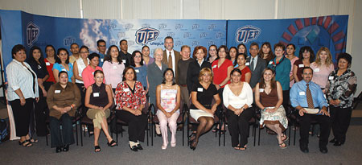
EPCC Transfer Scholarship 1997 - present
Wolslager Foundation • $6,000/year for two years
• 354 awards to date • 95% retention rate
• 2008 THECB Star Award • over $2.5 million to date

Slide 20
Academic Advising
Shared Academic Advisor Professional Development every semester
UTEP Advising Center at EPCC Valle Verde
UTEP Advising at EPCC / Fort Bliss

Slide 21
Curricular and Academics
Transfer Guides
2 + 2 Degree Plans
NIH Border Bridges to the Baccalaureate
NSF GK 12 Fellows
Reciprocal Honors Program
Early College High School

Slide 22
Transfer Guides & 2 + 2
All College of Engineering UG Degrees
All College of Health Science UG Degrees
College of Business Administration – BBA
College of Liberal Arts
Chicano Studies - English in progress
Communication
College of Education (Bachelor of Interdisciplinary Studies)
School of Nursing, via the RN-BSN program
College of Science – all in process

Slide 23
Early College High School
Since 2002, the partner organizations of the Early College High School Initiative have started or redesigned more than 200 schools in 24 states and the District of Columbia. The schools are designed so that low-income youth, first-generation college goers, English language learners, students of color, and other young people underrepresented in higher education can simultaneously earn a high school diploma and an Associate’s degree or up to two years of credit toward a Bachelor’s degree—tuition free. www.earlycolleges.org

Slide 24
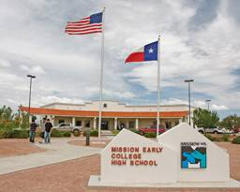
El Paso Area Early College High Schools
Mission (Socorro ISD)
Valle Verde (Ysleta ISD)
Transmountain (El Paso ISD)
Northwest (Canutillo ISD)
Cotton Valley (Fabens, Tornillo, and Fort Hancock ISDs)
Clint (Clint ISD – Fall 2012)

Slide 25
ECHS Enrollment Estimates

Slide 26
100 – 125 per graduating class
Full enrollment at all six schools:
600 – 750 graduating ECHS seniors each year
Estimating 75% attendance at UTEP:
450 – 565 incoming students ≈ 10 - 15% junior class

Slide 27
Important Themes
Top to Bottom Cooperation
Side to Side Cooperation
Overlapping Cooperation
Long term Commitment
Multiple Perspectives
Student Centered Focus

Slide 28
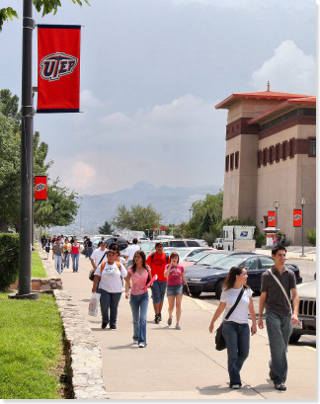
During any given semester, 80 – 85% of UTEP students have taken classes at EPCC.

Slide 29
Thank you

