Slide 1
Something Better Than in the Middle: HB 1042, the Common Core, and Increased Educational Attainment in Missouri
Rusty Monhollon, Assistant Commissioner for Academic Affairs
Missouri Department of Higher Education
2013 COTA Conference on Transfer and Articulation
Columbia, Missouri

Slide 2
Stuck in the Middle
Missouri ranks
20th in the number of students taking college entrance examinations;
22nd in completions;
24th in college participation;
24th in students who complete a bachelor’s degree in six years;
26th in degree completions per 100 students;
27th in adults who hold an associate degree or higher.
29th in providing need-based financial aid;
31st in high school completion rates;
33rd in adults who hold a bachelor’s degree or higher;
33rd in students with low amounts of student loan debt.
34th in the number of qualified teachers;
34th in college readiness;
39th in affordability;
41st in the number of high school students taking AP exams.
Notes:
National Assessment of Educational Progress (NAEP), conducted by the National Center for Educational Statistics

Slide 3
So?
State comparisons are unfair?
Educators failed our children?
U.S. falling behind other nations in educational attainment?
Dire consequences?

Slide 4
President Obama’s challenge, Governor Nixon’s charge
Increase educational attainment
The CBHE has endorsed what we refer to as “the Big Goal”:
We will increase the proportion of Missourians with high-quality* postsecondary credentials to 60 percent by 2025.
*credentials that provide clear pathways to further education and employment.
Notes:
High-quality: credentials that provide clear pathways to further education and employment.

Slide 5
Why increase educational attainment?
Americans holding a postsecondary credential constant for last 40 years.
Our knowledge-based society and economy demands workers with greater skills and knowledge.
By 2018, 59 percent of all jobs in Missouri (1.8 million) will require postsecondary education.
It’s the key to economic growth and building a better society.
improve the economy, strengthen civic engagement and reduce the costs of crime, poverty and health care
In short, improve the human condition.
Close the “attainment gap,” which is widening and of particular concern given the country’s demographic trends.
Notes:
“Help Wanted: Projections of Jobs and Education Requirements Through 2018.” The Georgetown University Center on Education and the Workforce

Slide 6
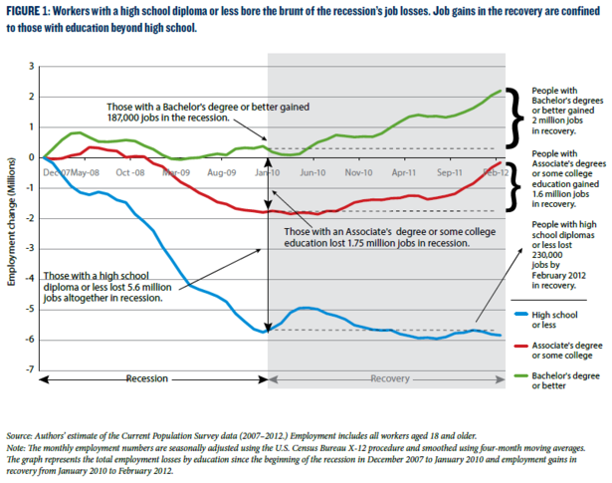
Educational attainment and income

Slide 7
How close are we to the “Big Goal”
2012: ~46 percent of Missourians hold a high-quality postsecondary credential.
At current rate, Missouri will reach 45 percent by 2025
400,000 shortfall.
2025: To reach 60 percent, we’ll need to add 3,000 new degrees each year.
Notes:
Current production is about 50,181. Need 461,886 additional degrees to reach 60 percent.

Slide 8
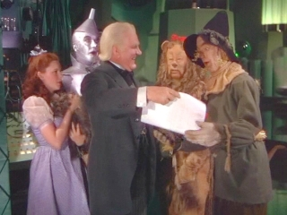
How do we get there?
“Why, anybody can have a brain. That's a very mediocre commodity. Every pusillanimous creature that crawls on the Earth or slinks through slimy seas has a brain. Back where I come from, we have universities, seats of great learning, where men go to become great thinkers. And when they come out, they think deep thoughts and with no more brains than you have. But they have one thing you haven't got: a diploma.”

Slide 9
Really, how will we achieve the Big Goal?
By focusing on three key areas:
Assuring that students are academically prepared and ready for postsecondary education.
Reducing time to completion.
Assuring academic rigor and quality.

Slide 10
HB 1042
Develop library with at least 25 courses accepted in transfer as equivalent by all institution
Develop a reverse transfer policy
Replicate best practices in developmental education

Slide 11
Transfer Course Library
require all public two-year and four-year higher education institutions to create by July 1, 2014, a statewide core transfer library of at least twenty-five lower division courses across all institutions that are transferable among all public higher education institutions [and]. . . treated as equivalent to similar courses at the receiving institutions.
Transfer students “lose” credits
Courses transfer, but not always as “equivalent”

Slide 12
Mean credit hours accumulated for native vs. 42 hour block and AA students
 | Native students | 42-hour students | AA students | Average tuition per credit hour | Additional costs/42-hour students | Additional costs/AA students
Full-time | 128.95 | + 9.7 | + 6.96 | $196.58 | $1,906.83 | $ 1,368.20
Part-time | 130.08 | + 6.49 | + 6.95 | $196.58 | $1,275.80 | $1,366.23

Slide 13
Transfer Course Library
Identify courses that appear to transfer widely using information obtained from IHE transfer website
Confirm that courses not on website do not transfer, or simply have never transferred between institutions.
Information is one-directional and limited.
A course may from institution A to institution B but may not transfer from B to A; or
The courses may transfer from institution A to institution B as HIST 101→HIS 100, but from institution B to institution A as HIS 100→HIST 200).
Course transfers from A to B; does it transfer from A to C?
Uncertain how up-to-date information is on the transfer website

Slide 14
Reverse Transfer
The problem:
Missouri has 747,000 working-age adults have attended college but don’t have a degree.
develop a policy to foster reverse transfer for any student who has accumulated enough hours in combination with at least one public higher education institution in Missouri that offers an associate degree and one public four-year higher education institution in the prescribed courses sufficient to meet the public higher education institution's requirements to be awarded an associate degree.

Slide 15
Missouri Reverse Transfer Initiative (MRTI)
All of Missouri’s public institutions and (currently) 10 independent institutions.
Supported by $500,000 grant from the Lumina Foundation (Credit When It’s Due)
15 one-to-one agreements currently exist; use as building blocks for a truly statewide system.
Connect all institutions to streamline communication.
Have capability to expand for other needs:
Student portal
Financial aid information
Common application
Electronic diplomas

Slide 16
Goals and Status
Steering Committee and five workgroups
Technology
Implementation
Policy
Data
Communications
Implementation by October 2014

Slide 17
“Replicate Best Practices” in Remediation
The coordinating board for higher education shall require all public two-year and four-year higher education institutions to replicate best practices in remediation identified by the coordinating board and institutions from research undertaken by regional educational laboratories, higher education research organizations, and similar organizations with expertise in the subject, and identify and reduce methods that have been found to be ineffective in preparing or retaining students or that delay students from enrollment in college-level courses

Slide 18
Remediation in Missouri
Nationally, about 41 % of all students require remedial coursework
Only about 15 % continue on to college-level work in one year; still fewer get degree
In Missouri, data on remediation is limited to public institutions
36 % take remedial course
54 % at open enrollment institutions
Why a problem?
Takes longer to complete degree, if at all
Each remedial course significantly reduces likelihood student will ever earn a degree
Inefficient: resources diverted from degree completion
Costs: paying twice?

Slide 19
Challenges
Incomplete data: don’t know the precise rate of remediation
No precise definition of what constitutes “remedial coursework”
Resistance about validity of remediation rate
Remedial coursework is an easy political target

Slide 20
Status
MDHE staff analyzing data from Dev. Ed. Survey
All publics; 10 independent institutions respond
Definition of dev. ed. seems to vary
Range of support services, placement tools, and policies
Taskforce on College and Career Readiness
Reviewing placement policies
Will make recommendations

Slide 21
Common Core State Standards
Joint effort between NGA and the CCSSO to develop rigorous standards in mathematics and English
Define the knowledge and skills students should have within their K-12 education careers so they will be able to succeed in college-level coursework and workforce training programs

Slide 22
Smarter Balanced Assessment Consortium (SBAC)
Measure the level of student proficiency in mastering the common core standards in mathematics and English
Achieving a certain score (yet to be determined) will be an indicator that the student has a good chance to succeed in credit-bearing college courses.

Slide 23
Potential Impact on Higher Education
Education programs will have to incorporate into teacher preparation programs
Pre-service and post-placement professional development
Align K-12 and postsecondary curriculum
Consistent placement tools across institutions
Recommendations for high school curriculum
12th grade interventions for students
address deficiencies, course schedules for students who are on track, and accelerated options for advanced students.
Has the potential to:
Reduce remediation rate
Improve degree completion
Reduce costs of obtaining education

Slide 24
What is College Readiness? Who Defines?
Institutional placement tests are blunt assessment instruments
General predictor of success in college, not identify precise skills students lack.
Studies suggest many students identified for remedial coursework can succeed without remediation
Need to identify better diagnostic tools to place students

Slide 25
College readiness
College readiness means students have the knowledge, skills, and behaviors to complete a college course of study successfully, without remediation.

Slide 26
Where are we with implementation of CCSSI?
Aligning curriculum was relatively easy
There’s not a lot of disagreement on WHAT students should know and WHAT skills they should possess
Broad consensus in support of curriculum alignment
HOW DO WE KNOW IF THEY’RE READY?
Where will the line be drawn to delineate college readiness?

Slide 27
An Opportunity for Something Better than “In the Middle”
We will get all students prepared for college and career
We will give them clear pathways to further education and employment.
We will increase educational attainment
We will reduce time to completion by streamlining transfer
We must change public perceptions
Build appreciation of education’s value and economic impact
Increase awareness that our competiveness in the global economy depends on a strong public system
Foster a sense of urgency about higher education

