Slide 1
Transfer of Introductory
STEM Courses
Tim Walston (Biology)
Barbara Kramer (Chemistry)
David Garth (Mathematics)

Slide 2
Truman’s STEP (STEM Talent
Expansion Programs) Office
Partnering with three Missouri community colleges
(2004-present)

Slide 3
Transfer Success in STEM
November 14-15, 2013
Meeting of STEM faculty from the four institutions
Inspiration from STEP Office Advisory Committee
Funded by Truman Vision Initiative Award
Goal: Get faculty from the schools to discuss transfer in STEM disciplines

Slide 4
Transfer Success in STEM
November 14-15, 2013
Outline of Agenda
Trends in Truman STEM Transfer
“What challenges do we face?”
  Disciplinary break-out discussions
“What challenges did we face?”
  Transfer student panel
“What challenges can we fix?”
  Institutional break-out discussions

Slide 5
The Problem
Transfer students are behind their same-age peers after transferring to a 4-year school
Students who transfer to pursue a STEM degree are farther behind than those who pursue a non-STEM degree

Slide 6
Average time-to-graduate is greater for STEM transfers than both non-STEM and native STEM
Average Native Truman Time-to-Graduate
STEM grad | Non-STEM
4.22 | 4.22
Average Transfer Truman Equivalent Time-to-Graduate
STEM grad | Non-STEM
5.01 | 4.79
STEM grad
5.01
All data represent transcript analysis of US citizen students enrolled at Truman State University from 1998 to 2012.
“Transfer” (N=2042) and “Native” (N=11,465) are as designated by Truman on transcripts.
Equivalent Time-to-Graduate was determined by assuming that one academic year consists of 2 15-credit hour semesters.

Slide 7
Transferring has a larger impact on time-to-graduate for STEM majors than non-STEM

Slide 8
Total time-to-graduate is generally greater for STEM than non-STEM transfers
Non-STEM
< 4 yrs | 2.1 %
4-5 yrs | 79.2 %
> 5 yrs | 18.7 %
Equivalent years-to-graduate for transfer students at Truman who graduate
with a non-STEM major

Slide 9
Total time-to-graduate is generally greater for STEM than non-STEM transfers
STEM
< 4 yrs | 0 %
4-5 yrs | 72.2 %
> 5 yrs | 27.8 %
Equivalent years-to-graduate for transfer students at Truman who graduate
with a STEM major

Slide 10
The delay in time-to-graduate is caused by many different problems
AA vs. AS degrees
Advising challenges
“Transfer swirl”
Math preparedness
Course alignment
  Equivalencies
  Sequencing
  Availability

Slide 11
The 42-hour block and the AA degrees do not prepare students for STEM transfer
General Education (42-Hour Block) | MACC | MCC | SCC
Communication (Composition and Speech) | 9 | 9 | 9
Humanities (Art, Drama, Foreign Language, History, Literature, Music, Philosophy) | 6 + 3 (Literature) | 9 | 9
Social and Behavioral Sciences (Anthropology, Economics, Geography, History, Political Science, Psychology, Sociology) | 9 | 6 + 6 (Hist./Pol. Sci.) | 9
Physical and Biological Sciences (Biology, Chemistry, Geology, Physical Geography, Meteorology, Physics) | 9 | 9 | 7
Mathematics | 3 | 3 | 3-4
Additional General Education Requirements | 3 (Computer) |  | 3 (Multicult.) 1 (Capstone)
AA Requirements
Additional AA Requirements | 1 (Orientation) | 3 (Computer)
Electives | 21 | 17 | 22
To be on track with “same age” peers, a Biology transfer student needs 16 credits of Biology, 14 credits of Chemistry, and 5 credits of Mathematics (completion of Calculus I).

Slide 12
AS not considered transferrable
Many AS degrees currently only focus on pre-engineering and not other STEM disciplines

Slide 13
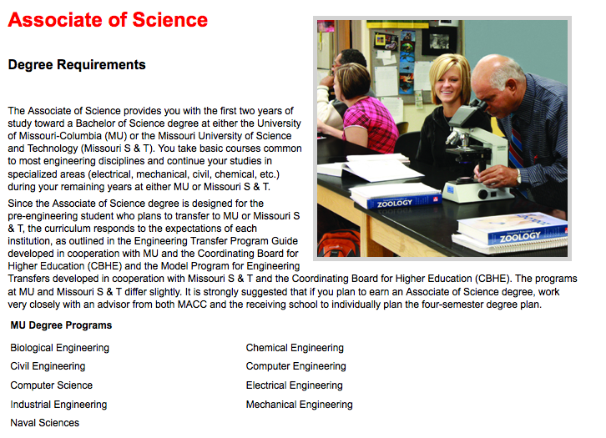
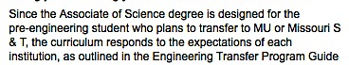
Current AS Description at MACC

Slide 14
AS not considered transferrable
Many AS degrees currently only focus on pre-engineering and not other STEM disciplines
Even those that are designed for other STEM disciplines often do not overlap with typical 4-year STEM major plans

Slide 15
Year 1 Biology Major Schedule
Sem | Truman Bio Major |  | MCC Biology Major
FALL | Intro Biology I | 4 | General Botany | 5
 | Intro Chem | 3 | Preparatory Chemistry | 5
 | College Algebra | 3 | College Algebra | 3
 | STEM hours: | 10 | STEM hours: | 13
SPRING | Intro Biology II | 4 | General Zoology | 5
 | Gen Chem I | 4 | Gen Chem I | 5
 | Trigonometry | 2 | Statistics | 3
 | STEM hours: | 10 | STEM hours: | 13
General Botany 5
General Zoology 5
Transfer as
Non – Major courses

Slide 16
Year 2 Biology Major Schedule
Sem | Truman Bio Major |  | MCC Bio Major
FALL | Cell Biology | 4 | Gen Chem II | 5
 | Gen Chem II | 4 | Gen Physics I | 5
 | Calculus I | 5
 | STEM hours: | 13 | STEM hours: | 10
SPRING | Genetics | 4 | Princ of Genetics | 4
 | Organic Chem I | 3 | Gen Physics II | 5
 | Statistics | 3
 | STEM hours: | 10 | STEM hours: | 9
Principles of Genetics 4
Organic Chem I 3
Not available in Spring
at MCC
Only transferrable option of all Biology Electives

Slide 17
Year 3 Biology Major Schedule
Sem | Native Bio Major |  | MCC Transfer Bio Major
FALL | Ecology | 4 | Intro Biology I | 4
 | Organic Chem II | 3 | Trigonometry | 2
 | Organic Chem I Lab | 1 | Organic Chem I | 3
 | STEM hours: | 8 | STEM hours: | 9
SPRING | Physiology | 4 | Intro Biology II | 4
 | Physics I | 4 | Organic Chem II | 3
 | Organic CHEM II Lab | 1 | Organic Chem I Lab | 1
 |  |  | Calculus I | 5
 | STEM hours: | 7 | STEM hours: | 13
Trigonometry 2
Not required at MCC;
Pre-requisite for Calculus I

Slide 18
Year 4 Biology Major Schedule
Sem | Native Bio Major |  | MCC Transfer Bio Major
FALL | Physics II | 4 | Cell Biology | 4
 | Bio Elective 1 | 4 | Ecology | 4
 | Bio Elective 2 | 4 | Bio Elective 1 | 4
 |  |  | Bio Elective 2 | 4
 | STEM hours: | 12 | STEM hours: | 16
SPRING | Bio Elective 3 | 4 | Physiology | 4
 | Bio Elective 4 | 4 | Bio Elective 3 | 4
 |  |  | Bio Elective 4 | 4
 |  |  | Organic Chem 2 Lab | 1
 | STEM hours: | 8 | STEM hours: | 13
With current course options at MCC, even with a well-thought out AS, transfer students take an average of 13 STEM hours a semester in year 3 and 4 while native students take 9 STEM hours.

Slide 19
The delay in time-to-graduate is caused by many different problems
AA vs. AS degrees
Advising challenges
“Transfer swirl”
Math preparedness
Course alignment
  Equivalencies
  Sequencing
  Availability

Slide 20
Advising pre-STEM students in the community college is a challenge
Identification of “pre-STEM” students does not occur in most cases
Students either don’t get advising or don’t follow advising recommendations
STEM faculty become informal advisors for select students
Students do not read the catalogs of either institution
Students need to be planning for transfer at matriculation (i.e., already identified potential transfer institutions, know major course requirements and transfer equivalencies, etc.)

Slide 21
The delay in time-to-graduate is caused by many different problems
AA vs. AS degrees
Advising challenges
“Transfer swirl”
Math preparedness
Course alignment
  Equivalencies
  Sequencing
  Availability

Slide 22
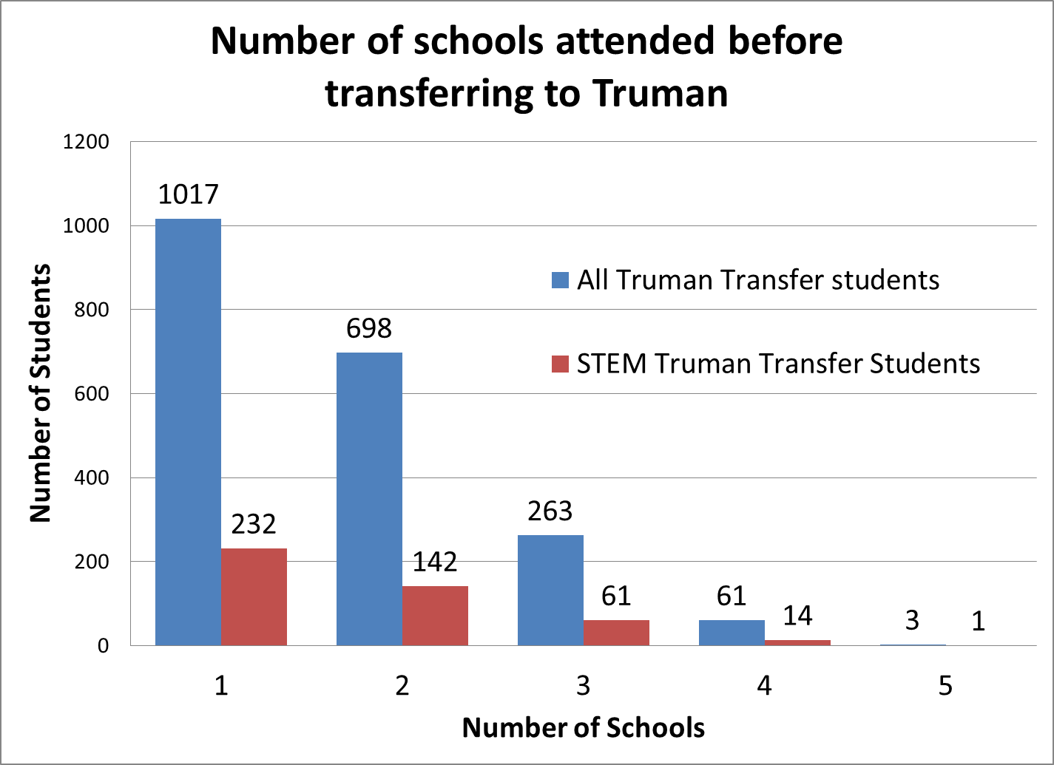
“Transfer Swirl” and course sequencing make advising even more difficult in STEM
Differences in requirements can prevent students from taking courses needed for STEM degrees

Slide 23
The delay in time-to-graduate is caused by many different problems
AA vs. AS degrees
Advising challenges
“Transfer swirl”
Math preparedness
Course alignment
  Equivalencies
  Sequencing
  Availability

Slide 24
Math preparedness and math requirements can cause delays in transfer or graduation in STEM
Sem | Calculus | College Algebra | Int. Algebra | Intro. Algebra
1F | Calculus I | College Algebra | Intermediate Algebra | Introductory Algebra
1S | Calculus II | Trigonometry | College Algebra | Intermediate Algebra
2F | Calculus III | Calculus I | Trigonometry | College Algebra
2S |  | Calculus II | Calculus I | Trigonometry
3F |  | Calculus III | Calculus II | Calculus I
3S |  |  | Calculus III | Calculus II
4F |  |  |  | Calculus III
4S

Slide 25
The delay in time-to-graduate is caused by many different problems
AA vs. AS degrees
Advising challenges
“Transfer swirl”
Math preparedness
Course alignment
  Equivalencies
  Sequencing
  Availability

Slide 26

Community College STEM Courses Do Not Align with STEM Major-Level Courses
Introductory Biology Courses Do Not Fulfill Freshman Biology Course Requirements at Six of Eleven Public 4-Years
Metropolitan CC | Truman | UM-Columbia | UM-Kansas City | UM- St. Louis | MO Southern | Missouri State | MO Western | NW Missouri St. | SE Missouri (Org., Eco., & Evol.) | U. of Central MO | Missouri S&T
BIOL 104: General Botany
BIOL 106: General Zoology |  |  |  |  |  |  | 1 of 2 |  |  | Fulfills SO req.
Both courses taken |  | 1 course
Notes:
SEMO Biomedical and Cell and Molecular - Neither course works

Slide 27
Courses need to be re-evaluated regularly
Modern STEM courses are regularly changing
When courses change, transfer staff and other institutions need to be notified
  Labor intensive, need transfer staff
  Requires communication by/between faculty
  Examples:
    Computer science courses were not listed as equivalent, but actually were
    MACC “College Physics” (Calc-based) series counted as Truman’s “College Physics” (non-Calc) rather than “Physics with Calculus” series

Slide 28
The delay in time-to-graduate is caused by many different problems
AA vs. AS degrees
Advising challenges
“Transfer swirl”
Math preparedness
Course alignment
  Equivalencies
  Sequencing
  Availability

Slide 29
Course sequencing and frequency of course offering make scheduling more difficult in STEM
STEM courses often require a strict sequence of pre-requisites
Course scheduling can make it difficult to complete pre-requisites in a timely manner
Faculty recommend students take an entire sequence (i.e. Phys I and II or Calc I, II and III) at the same institution

Slide 30
Course sequencing and frequency of course offering make scheduling more difficult in STEM
Sem | Calculus-Ready |  | Not Calculus-Ready
 | Ideal | Actual | Ideal | Actual
1F | Calculus I | Calc I | College Algebra | College Algebra
1S | Phys I + Calc II | Calc II | Calculus I | Calculus I
2F | Phys II + Calc III | Phys I + Calc III | Phys I + Calc II | Phys I
2S |  | Phys II | Phys II + Calc III | Calculus II
3F |  |  |  | Calculus III
3S |  |  |  | Phys II
Phys I
Phys II
Calc II
Calc III
Not offered this semester
Current MACC Physics and Calculus scheduling
Note: Trigonometry recommended but not required as a pre-requisite for Calc I at MACC

Slide 31
The delay in time-to-graduate is caused by many different problems
AA vs. AS degrees
Advising challenges
“Transfer swirl”
Math preparedness
Course alignment
  Equivalencies
  Sequencing
  Availability

Slide 32
High demand for initial STEM courses can prevent students from starting a sequence on time
At most 4-year schools, seats in introductory STEM classes are reserved for first-time freshman
Seats are also reserved in high-demand sophomore courses to help keep majors on track
These options aren’t possible at many CC’s
  Advising not geared toward STEM students
  Students have not identified as “STEM”
  Students enroll late
  Course demand prevents “saving seats”

Slide 33
Sophomore STEM courses often not offered at CC or offered infrequently
Sem | Truman | SCC | MCC | MACC
1F | Gen Chem I | Gen Chem I | Gen Chem I | Gen Chem I
1S | Gen Chem II | Gen Chem II | Gen Chem II | Gen Chem II
2F | Org I + Quant | Org I + Quant | Org I (+ Lab)
2S | Org II + Org I Lab | Org II + Org I Lab | Org II (+ Lab)
3F | P Chem I + Org II Lab | P Chem I + Org II Lab | Quant | Org I + Quant
3S | P Chem II + Inst | P Chem II + Inst | P Chem II | Org II + Org I Lab
4F | Inorg Chem | Inorg Chem | P Chem I + Inorg | P Chem I + Org II Lab
4S | Biochem + Adv | Biochem + Adv | Biochem + Adv | P Chem II + Inst
5F |  |  |  | Inorg Chem
5S |  |  |  | Biochem + Adv
Quant
Quant
Q + O on books but not taught
Quant
Org I + Quant
Org II + Org I Lab
Resource intense course not often taught at CC
Recent addition of Quant allows smooth transfer
Quant in year 3 requires non-ideal sequence in 3/4
Students cannot graduate in fewer than 5 years total

Slide 34
Conversations between and within schools are starting to lead to solutions
Obvious equivalency problems addressed
Course re-design is under discussion
AS degrees are being redesigned
Advisors are changing how they work with STEM majors
Potential course innovations and resource sharing are being considered
Communication lines are staying open

Slide 35
IDEA: Strengthening University and Community College Educational Environments for Degrees (SUCCEED) in STEM
Fully develop Pre-STEM Pathways programs with reverse transfer
  Mechanism for identification as a Pre-STEM student
  Pre-STEM advisor at each community college
Facilitate articulated STEM AS degree programs
Summer STEM Bridge Programs
  Residential summer program
  Hybrid summer program

Slide 36
IDEA: Statewide/Midwest meeting of STEM faculty and transfer staff
Raise awareness of transfer students
Disciplinary discussions
  Barriers
  Possible solutions
  Formation of multi-institution working groups
Keynote speakers: STEM education guru, STEM transfer guru
Is this something your institution would send attendees to?

Slide 37
What are your experiences?
What other solutions should be examined?

Slide 38
Truman State University STEM Talent Expansion Programs (STEP) Office
Web Portal: http://step.truman.edu
Email: step@truman.edu
Phone: 660.785.7252
Acknowledgements: Dean De Cock, Statistical Consultant

