Slide 1
Importing Transfer Equivalencies: How to Maximize Efficiency
How Columbia College Office of Registrar improved productivity through third party solutions
Notes:
Tim/Scott

Slide 2
Columbia College Office of the Registrar - Evaluations
Serves all 35 campuses Nationwide, including online campus
From 2012-13: 32,000+ active students
Evaluators are trained to award transfer equivalencies and do not require academic department approval
24 Evaluators are trained to determine and grant equivalencies
Since 2010, Columbia College has received transcripts from more than 2,000 different schools
Notes:
Scott

Slide 3
The Evaluation Process Prior to Implementation of TES/TCE processes
All credit evaluated on an individual basis
Equivalencies created in database as needed
Some equivalencies already created depending on frequency of transcripts submitted from school
Added and applied manually
No correlation or connection between equivalency guides and SIS (Student Information System)
Acceptable Turnaround time: 10 Days
Could vary from 2 to 4 weeks
Notes:
Scott

Slide 4
Efficiency Hurdles
Equivalency guides were a labor intensive process with minimal benefits
Equivalency guides difficult to keep updated and accurate
Manual data entry of transcript information
Forced reactionary due to daily workload
Notes:
Scott

Slide 5
Efficiency Goals
Streamline equivalency guide process
Utilize equivalency guides for multiple purposes
Reduce manual data entry of transcripts
Streamline the evaluation process
Notes:
Tim

Slide 6
The Equivalency Guide Process
Guides powered by CollegeSource’s TES (Transfer Evaluation System)
Create Equivalencies for every individual course
Streamlined review process and reduced timeframe
Equivalency Explorer for potential reverse transfer opportunities
New public view offers tools for academic advisement
Notes:
Scott

Slide 7
Changes in TES Helped Improve New Guides
Overarching Date ranges replace individual catalog years
Greatly reduces amount of data
Less to manage
Less stress on server, making TES-powered guides quicker
Improves both our guides as well as...
Notes:
Scott

Slide 8
The Data Import Process
Data from TES imported into Columbia College Equivalency Tables
An entire course catalog can be done quicker than manual entry for single transcript
TES 3.0 will reduce the overall number of equivalencies, while increasing accuracy of large date ranges
Notes:
Scott

Slide 9
Automated Data Entry
Notes:
Tim

Slide 10
Optical Character Recognition (OCR)
Paper documents are scanned and converted to electronic text documents.
Allows automated data entry and retention of paper copies.
Notes:
Tim

Slide 11
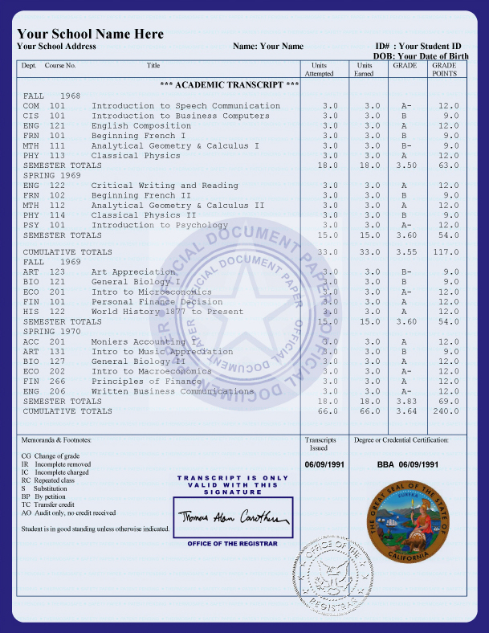
Zonal OCR allows users to create templates that identify document fields.
It mirrors the manual data entry process by telling the computer which values on the transcript are relevant to the student record.
Slight OCR errors can be corrected by programming the template to replace certain values (e.g. ENG1 corrected to ENGL).
A suspect level can be set to ensure accuracy of data entry. Commercial grade OCR software is approximately 71%-98% accurate.
Notes:
Tim

Slide 12
How Columbia College’s process works:
The user manually selects the name of the school from which the transcript originated by selecting from a drop-down menu (within the scanning software interface).
This determines the image processing needed to create a perfect black and white image of the transcript.
The OCR process then runs based on our templates and pulls all institutional courses with a grade of “C” or higher.
Notes:
Tim

Slide 13
How Columbia College’s process works:
Each transcript is manually reviewed to ensure the data was read correctly
Once accuracy has been verified the course equivalency data is added to the student’s record (but is not automatically applied).
Any courses that lack equivalency rules create a task to request rule creation.
Once all equivalency rules have been built, the transfer credit is ready to be fully applied to the students record.
Notes:
Tim

Slide 14
The Time it Takes...
Manual processes can take up to 30+ minutes per transcript. The speed is determined by individual data-entry skills and efficiency levels.
Automated processing can take as little as 8 minutes to process transcripts of any size.
Notes:
Tim

Slide 15
Pairing Automated Data Entry with TES CollegeSource
TES provides complete data sets of equivalencies in our SIS system.
This cuts down on manual creation of rules, user navigation and creates workflow tasks for rules that are needed.
Virtually eliminated manual equivalency rule creation for data sets that have been imported to the system.
Notes:
Tim

Slide 16
Total Savings
(July 30 2012- April 2013)
 | 2011-12 | 2012-13 | Change
Completed (Number of files) | 30,118 | 32,166 | +6.8%
Added (Number of Files) | 30,077 | 31,744 | +5.5%
Turnaround Time (business days) | 13.4 | 5.0 | -8.4 days
Three months after going live with both processes
Notes:
Tim

Slide 17
Questions???
Contact us at: TESQuestions@ccis.edu
Presenters: Scott Ziolko & Tim Horzmann
Notes:
Tim/Scott

