Slide 1
EmPowerPoint
Kelli A. Cronk, M.A., CCC-SLP
Reading Instructor/Speech-Language Pathologist/
Life-long Learner, MCC-Longview
COTA, Friday, February 1, 2013
Notes:
My name is Kelli Cronk.
I am a reading instructor and speech-language pathologist with MCC-Longview in Lee’s Summit, Missouri.

Slide 2

“If you do what you’ve always done,
you’ll get what you’ve always gotten.”
~ Anthony Robbins
Notes:
I’m going to share with you today what I have learned in the past year about engaging my developmental students with the support of highly visual PowerPoint presentations.
When I started using PPTs in the classroom, I knew I wasn’t supposed to read to students from the slides, but I didn’t know what do to instead.
I was “spinning my wheels”…like this hamster.
[I couldn’t find photo reference for this pic, but it isn’t mine!]

Slide 3

Notes:
Until I read PresentationZen by Garr Reynolds. This book was written in 2012.
There is a huge difference between my powerpoint slides before I read this book and afterwards.
Reynolds introduces a “Zen approach” to developing PPT presentations.
This is the “to do” I was looking for.
“This book should be required reading for all professionals and especially those aspiring to teach anyone about anything.” Garr Reynolds.
Photo from fr.amiando.com

Slide 4

Notes:
Since reading PresentationZen, I have also read a book entitled, Moonwalking with Einstein: The Art and Science of Remembering Everything.
In this book, Josh Foer (“Four”) reinforces the importance of our visual faculties in the process of remembering. Our memory for images is very strong
In the 1970’s scientists studied our capacity for visual memory by giving subjects a test called the “Two-alternative Picture Recognition Exam.”
Subjects were shown 10,000 pictures and told to remember them.
It took one week to show one subject all the pictures.
The pictures were shown very fast – less than half a second per picture. Each picture was shown only once. Examples: Neil armstrong’s footprint on the moon, red rose, Mohammed Ali, barbells
After waiting 30 minutes, subjects were shown two pictures side-by-side and asked to recall, “Which picture have you seen already?” Example: Two pics: Mohammad Ali, fizzling Alka-seltzer…point to picture you’ve seen before. Mohammed Ali.
People recalled 10,000 pictures with 80% accuracy.
More recently…this study was repeated with 2,500 images.
But this time the images were “closer together” in terms of subject matter.
People had to choose b/t images that were almost identical: a stack of five dollar bills vs stack of one dollar bills; a green train car vs a red train car; a bell with a narrow handle vs a bell with a wide handleEven if pics varied by a tiny detail, people still remembered the pics with 90% accuracy. The scientists also found that people be asked about the pictures several years later…and they would point to the right pics often than not.
Info from Moonwalking with Einstein by Joshua Foer
Photo from collider.com

Slide 5
Ebbinghaus
Curve of Forgetting
Notes:
Hermann Ebbinghaus’s experiments revealed a relationship between the forgetting of learned information over time.
He found that a good part of what a person forgets takes place within 20 minutes of the initial learning.
Within one hour, a person forgets nearly half of what was originally learned.
After 24 hours, almost 2/3 of the previously learned material is forgotten.
These results are known as the " Ebbinghaus Forgetting Curve."
He uncovered the fact that it is much harder to retain information that has no meaning for the learner.
He also showed that re-learning material is easier than the first time and that it takes longer to forget material the second.
Finally, he showed that a person will have greater success with learning if the studying is spread out over time, rather than engaging in a one night cram session. Students everywhere take note, true learning is a lifelong process.
Info from http://helpingpsychology.hubpages.com/hub/Ebbinghaus-Forgetting-Curve-The-Theory-of-Memory
Photo from PPT slide from Active Learning MCC Inservice, Zola Gordy

Slide 6

“Remembering can only happen if you decide to take notice.” ~ Joshua Foer,
Moonwalking with Einstein (2011)
Notes:
“Remembering can only happen if you decide to take notice.” ~ Joshua Foer, Moonwalking with Einstein
This quote speaks to the fact that remembering is an active process. I do not only use PPT presentations in my classes.
I also teach using small group work, clicker technology, informal quizzes, and other techniques. The pictures support other practices in my classroom.
Photo from bonniesbooks.blogspot.com

Slide 7
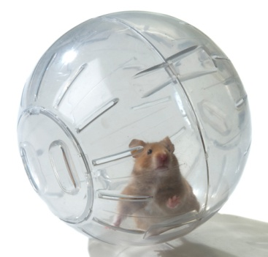
Notes:
Now I feel more like this hamster…I have more freedom and I have a process for creating PowerPoint presentations with clear messages that support, rather than dominate, my class lectures.
I feel very good having pictures behind me rather than words because I am more certain that students attention is directed toward me…rather than on copying down my wordy slides (maybe mindlessly copying) – or (worse) reading once and not taking any notes and forgetting. Really not keep either my verbal message OR my visual message (the words).
The pictures I use support my whole group instruction. I am certain students are listening to my words – while being engaged by the picture that is supporting my message. When there are too many words on the screen, students cannot concentrate listening to my message, reading the screen, and taking notes at the same time.
Reynolds says there are 3 parts to an effective PowerPoint presentation…
Photo from everythingaboutteddybearhamsters.com

Slide 8
1. Slides the audience will see
Notes:
Three Parts of PowerPoint Presentation:
Slides the audience will see. (Slides are to reinforce your words, not repeat them.)
Photo from everythingaboutteddybearhamsters.com

Slide 9
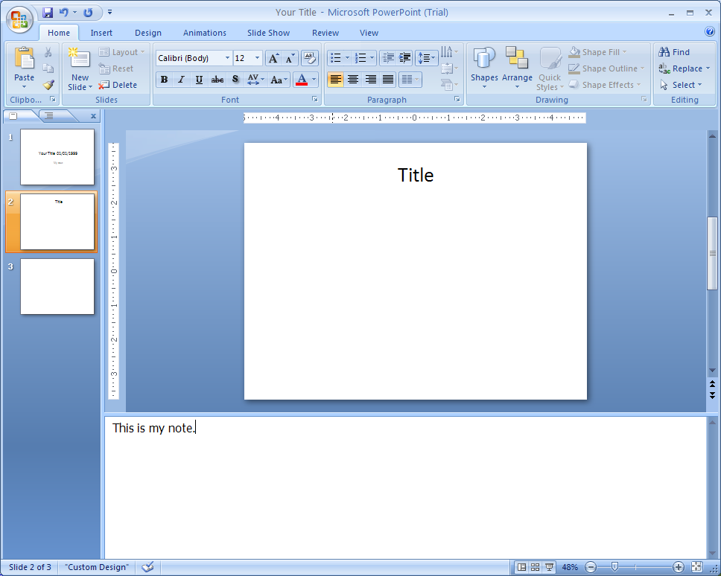

2. Notes only you will see
Notes:
Notes only you will see (within PPT document; for rehearsal and/or back-up)
Hamster photo from everythingaboutteddybearhamsters.com
PPT Notes photo from http://office.microsoft.com/en-us/word-help/link-or-embed-a-powerpoint-slide-HA010120811.aspx

Slide 10
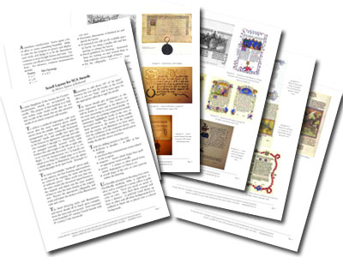
3. Handout to be taken away
Notes:
Handout to be taken away by audience
Photo from Handout photo from www.kellswood.com

Slide 11



Slides
Notes
Handout
Notes:
Adjusting these parts to the classroom…I consider the “handout” to be either
1) the course textbook or
2) the old, boring PowerPoint slides I made when I first started out.
These PPTs are available on Blackboard. Students can print them out as notes pages BEFORE class to assist their note-taking.
Students who have missed class can refer to this information to help them catch up.
Hamster photo from everythingaboutteddybearhamsters.com
PPT Notes photo from http://office.microsoft.com/en-us/word-help/link-or-embed-a-powerpoint-slide-HA010120811.aspx
Handout photo from www.kellswood.com

Slide 12
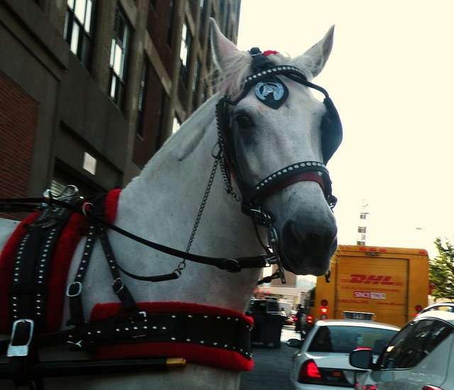
Before
Notes:
Here are some examples of my slides before reading PresentationZen.
Now that I know better, I am embarrassed to show you this.
The good news is that my old presentations are still useful…I’ll tell you about that later.

Slide 13
Remember Your STRENGTHS
Your achievements are determined by your motivations, desires, and goal-setting practices.
Numerous studies identify MOTIVATION as the single most important factor in academic achievement and graduation from college.
Two important parts to understanding your MOTIVATION:
1) You must have multiple motives (reasons)
for achieving and persisting
2) Your motives must be important to you personally.
Having only one reason for achieving (such as “to make more money”) or having a reason that pleases someone else (such as “My parents expect me to get an education.”) usually results in lesser achievement.
Notes:
This is a great example of “what not to do.”
Do not treat your slides like a word document.
It’s almost not our fault because PPT is set up with titles, bullet points, and lists,
but this isn’t the most effective way to reach people.
Long bullet points are not effective visually.

Slide 14
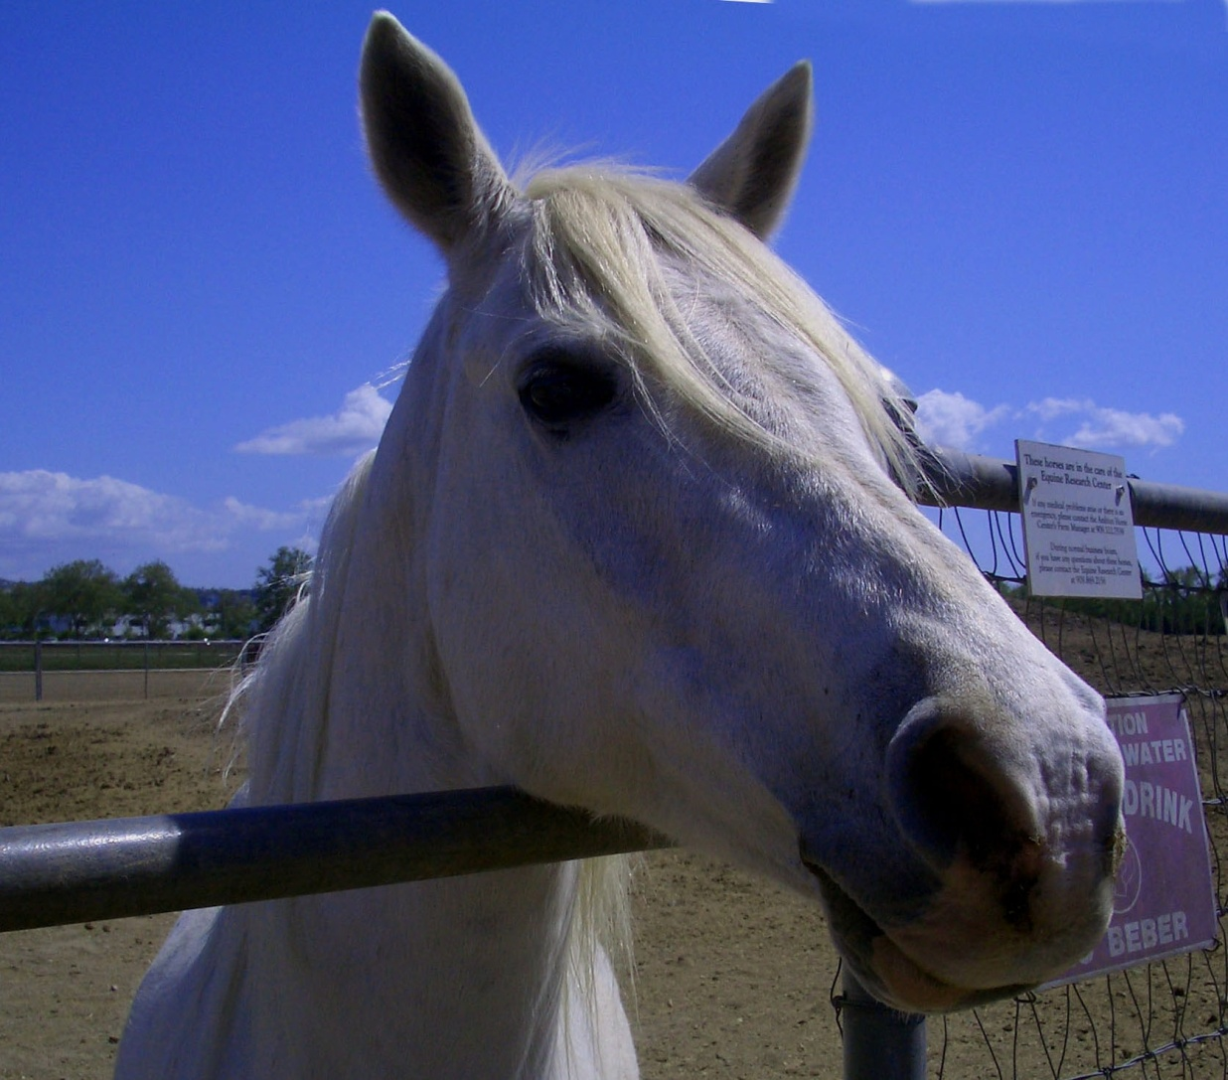
After
Notes:
No more blinders…back to Chapter 5: Thesis
[I couldn’t find where I got this photo from, but it isn’t mine!]

Slide 15

Never
never
never
give
up
~ Winston Churchill
Notes:
*Use professional pictures that “bleed off the slide”
*Use quotations sparingly. Make sure they are short and legible.
*Quotes can add credibility to your story.
*Consider placing the text within a larger photo.
*I got this picture free from www.istockphoto.com. You generally pay for these pics, but they offer one free pic per week…I got lucky.
Now I can read what was on the slide before about Remembering Your Strengths and Motivation…and students will listen…
Remember Your STRENGTHS!
Your achievements are determined by your motivations, desires, and goal-setting practices.
Numerous studies identify MOTIVATION as the single most important factor in academic achievement and graduation from college.
Photo from www.istockphoto.com

Slide 16
Remembering
The learner is able to recall, restate and remember learned information.
  Recognising
  Listing
  Describing
  Identifying
  Retrieving
  Naming
  Locating
  Finding
Can you recall information?
Notes:
Do not use cheesy clip art like this!
Slide from Bloom’s Revised Taxonomy presentation by Denise Tarlinton, Pupil Free Day, Monday 14 July, 2003
(Sorry, Denise!)

Slide 17
irony
  humor based on opposites: humor based on using words to suggest the opposite of their literal meaning
  something humorous based on contradiction: something said or written that uses humor based on words suggesting the opposite of their literal meaning
  incongruity: incongruity between what actually happens and what might be expected to happen, especially when this disparity seems absurd or laughable
Notes:
You get the idea!

Slide 18
irony
Notes:
IRONY:
a situation that is strange or funny because things happen in a way that seems to be the opposite of what you expected
the use of words that mean the opposite of what you really think especially in order to be funny
humor based on opposites: humor based on using words to suggest the opposite of their literal meaning
something humorous based on contradiction: something said or written that uses humor based on words suggesting the opposite of their literal meaning
incongruity: incongruity between what actually happens and what might be expected to happen, especially when this disparity seems absurd or laughable
SHOW: Aromatic Chemistry example from PresentationZen, pg. 198
Finding pictures to show abstract thoughts is challenging, but FUN…and effective.
Photo from www.nowpublic.com

Slide 19
What is a THESIS?
In what context (surroundings/environment) did you hear the word thesis?
What do you already know about the word thesis?
Notes:
Accessing prior knowledge…
You will see in my “after” slides that I still use slides like this during small group work.
I give directions and leave up questions for exploration.
When students say, “What are we doing?,” I refer them to the slide.

Slide 20
THESIS
(pg. 87 ) the central or unifying idea or ideas that the author has in mind as he or she composes an article [written publications], broadcast [radio/TV], or documentary [TV/video/film]
Notes:
Totally too much text... (Do not overload your slides with words or data.)
I want my students to “get” this information, but they are not able to listen to me speak and read the definition and take notes at the same time.
(No one can do all this adequately.)
Totally something I would have read from the slide ☹
Another good example of “what not to do”

Slide 21
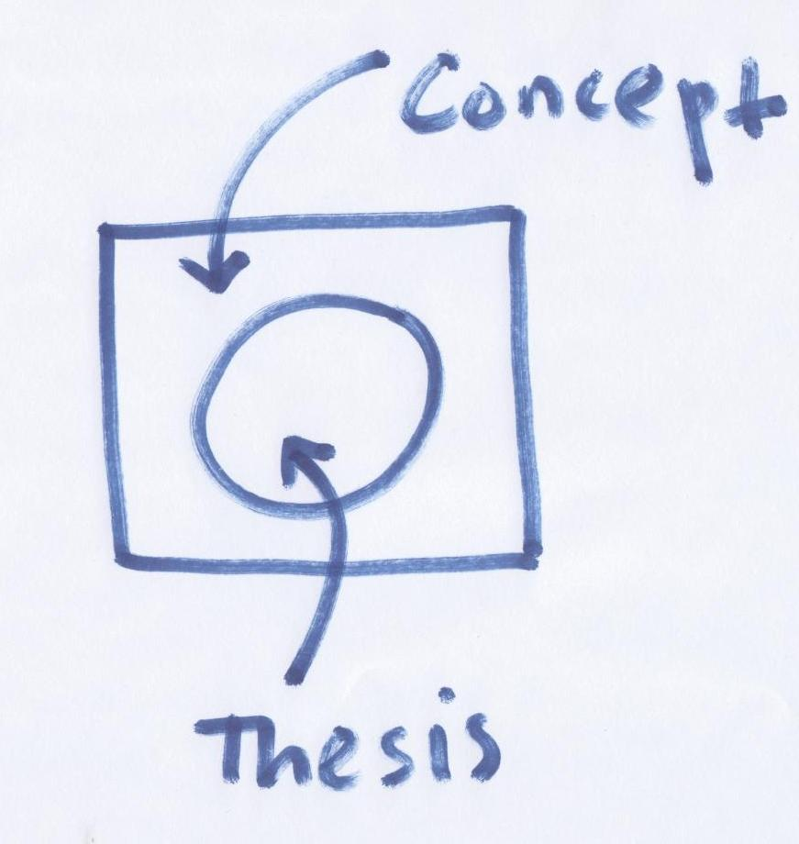
THESIS
Notes:
**This is where I give the definition of thesis***
(pg. 87) the major idea of a selection, of an entire passage, more than one paragraph
(pg. 87 ) the central or unifying idea or ideas that the author has in mind as he or she composes an article [written publications], broadcast [radio/TV], or documentary [TV/video/film]
So, the thesis is not just about writing.
NOTE: I will give you one more example of a set of updated slides.
Before I do, I also want to share with you how Reynolds suggests charts and graphs should be represented.
I don’t have much numeric data to share myself, and it was too difficult for me to replicate, so I will pass
around the book. pgs 135-137.
Photo from designthesis.wordpress.com/category/design-thesis-studio/

Slide 22
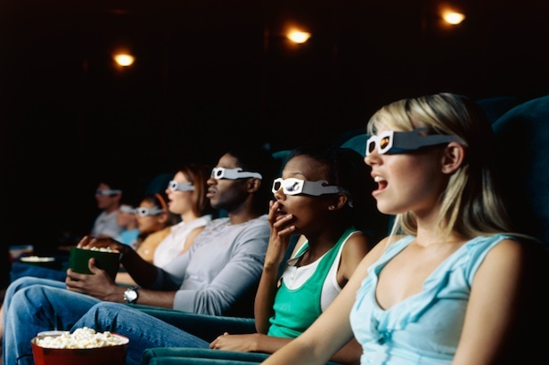
Previewing
Notes:
Students turn to Pg. 1 - MAP Introduction: metacognitive application process (MAP)
This is a self-questioning process to help you preview this textbook…and it can help you in other classes as well.
Each chapter in this book starts with these four questions: “Why?” - Why is this information important? Why is previewing important?
“What?” - What are the important parts? What information does the introduction provide for the reader?
What information does the introduction to BAMS include?
“How?” - How much do I already know about the topics presented? How can I apply the info?
How can you get more value from your textbook by reading the introduction?
and “What if?” I used this information right now? What if you could use this material right now in your other classes? - You could read introductions in other classes. You could use self-questions to preview material: Why, What, How, What if?
The questions are color-coded to help you visually. We will begin each new chapter using the MAP to preview.
Before we get started looking at Qualities of a Master Student together, I want to introduce you to a Master Student.
Photo from http://cdn.ientry.com/sites/webpronews/pictures/film3d3_616.jpg

Slide 23

paraphrasing
Notes:
How does one find a picture for “paraphrasing”? This is my attempt ☺
What usually goes in this advertisement? What else have you seen? What would you like to put?
Paraphrasing - putting information you have read into your own words
What can you paraphrase…a single word, a phrase or group of words, a whole sentence, a whole paragraph, a whole page/story/passage (retell)
[I looked, but could not find this photo reference online. Got it from a t-shirt vendor site.]

Slide 24

Part 2, Chapter 2 (P2C2): VOWELS
A VOWEL is the NUCLEUS of a
SYLLABLE
Notes:
For example, this is a READ 10 Chapter introduction slide…
Vowels are the “nucleus” of a syllable.
Photo from http://www.flickr.com/photos/argonne/6944232135/sizes/m/in/photostream/

Slide 25

Consonants Vs. Vowels
VOWELS:
Say, “Ah!”
Notes:
Consonants restrict the airflow somewhere in the vocal tract
Vowels are made with an open vocal tract…like in the picture.
TRY IT: (MAKE SOME NOISE!) /a/ /e/ /i/ /o/ /u/ (short)
/a/ /e/ /i/ /o/ /u/ (long)
It is challenging and fun to find pictures to represent the abstract concepts I am teaching.
I believe my efforts to do so are worthwhile. Reynolds gives an example in his book of the visual presentation of an aromatic chemistry professor.
She found this method effective for teaching pharmaceutical chemistry. In her example, the visual presentation forced her students to take notes.
Photo from myspace.com

Slide 26
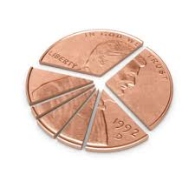
Financial Aid Services

Slide 27
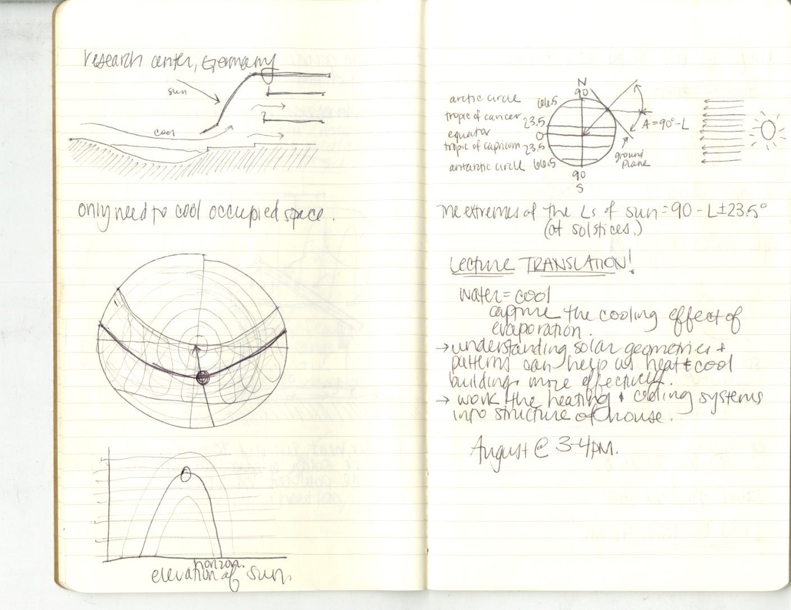
Notes with Diagrams
Notes:
Photo from andreakb.wordpress.com

Slide 28
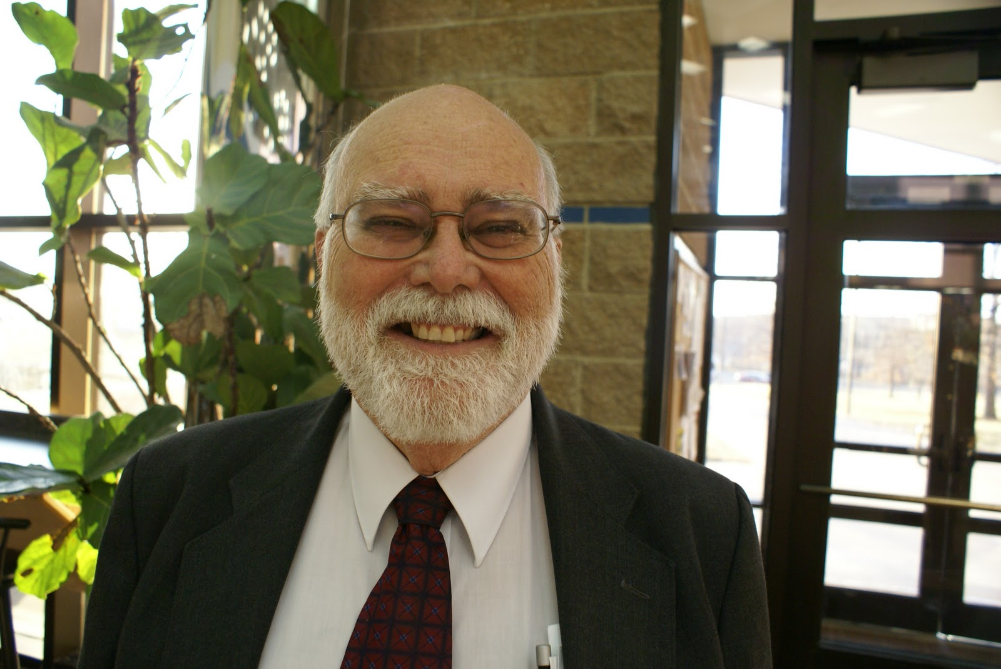
Dr. Marvin Aaron,
Dean of Student Development
Notes:
Introduce guest speakers
Photo from insidemcc.blogspot.com

Slide 29
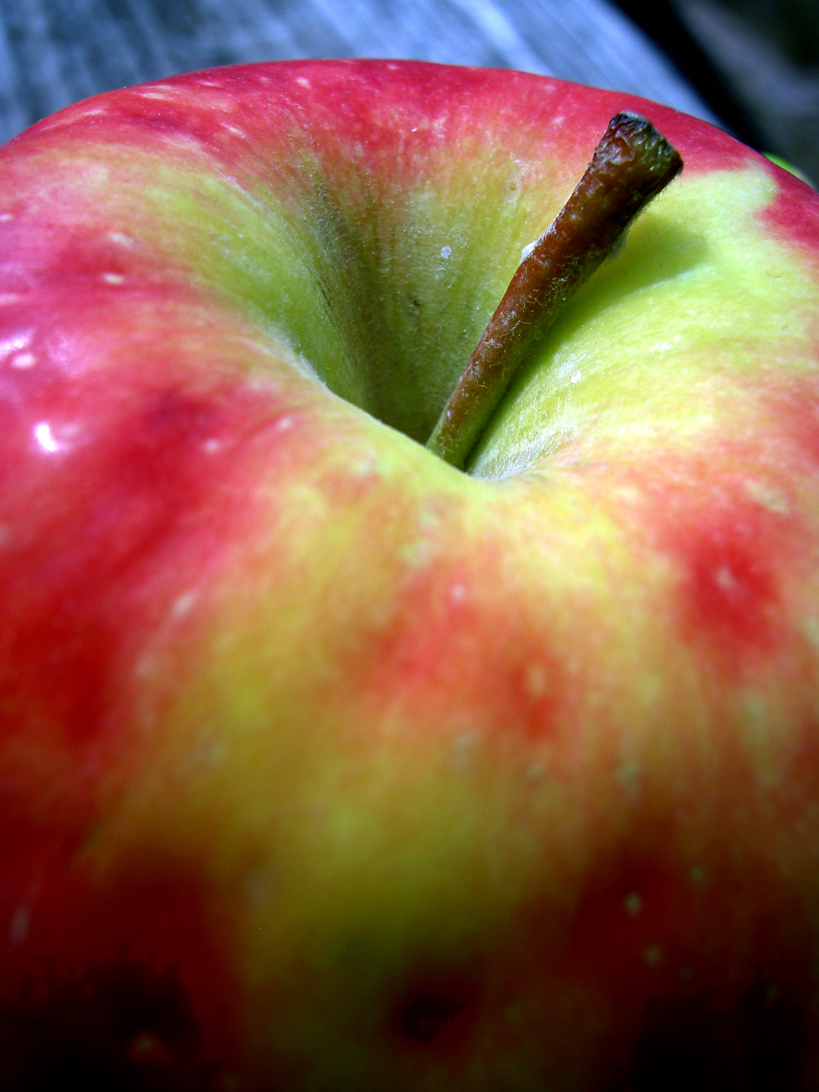
Homework: due Tues, 9/18)
Lecture Notes for Ch. 1 (9/4, 9/6, & 9/11)
(10 pts)
2. Exercise 8: The Time Monitor, pg. 66-70
(10 pts) * due in one week (Thurs, 9/20)
3. Read “The ABC Daily To-Do List,” pgs. 74-75
4. Read “Stop Procrastination Now,” pgs. 86-87
Notes:
Give homework directions…
Photo from http://www.morguefile.com/archive/display/553969

Slide 30

TEST Chapter 1 Breakdown:
*Open Book Test*
50 points
24 true/false &
multiple choice
4 short answer
1 concept map
Notes:
Give test breakdowns
Photo from jedalexander.blogspot.com

Slide 31
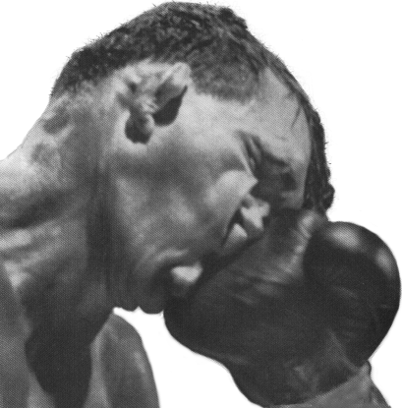
Notes:
I find pictures to be impactful.
My students remember them – and the ideas I have associated with them.
This visual method of engaging learners speaks to my sensibilities as a speech-language pathologist.
Students with special needs often need to have abstract, auditory information made visual to remember and understand it.
Photo from http://www.jayhanson.us/page89.htm

Slide 32

“The more strikingly visual your presentation is, the more people will remember it. And more importantly, they will remember you.” ~Paul Arden
Notes:
“The more strikingly visual your presentation is, the more people will remember it. And more importantly, they will remember you.” ~ Paul Arden
Follow design principles such as the “rule of thirds” and make sure peoples’/animals’ faces are looking toward your text, rather than away from it.
GIVE EmPowerPoint Presentation Handout!
(Now I need a class on how to DO handouts properly!)
Photo from ktvq.com

Slide 33
Photos in the presentation were
obtained through
www.flickr.com/creativecommons and
www.morguefile.com and
Google/Bing image searches
“Let it begin!”
~ Rhino
the
Hamster
in Bolt
Notes:
Photo from everythingaboutteddybearhamsters.com

Slide 34
Q&A
“I’ll get
my ball!”
~ Rhino
the
Hamster
in Bolt
Notes:
*Questions?
Photo from everythingaboutteddybearhamsters.com

