Slide 1
Transfer Credit Reevaluation – Simplified COTA Conference February 1, 2013
Don Simpson, Associate VP for Enrollment Management
Brian Edmond, Senior Systems Analyst

Slide 2
Missouri State University
21,000 students, with 15,000 degree-seeking undergraduates
2,352 new transfers in 2012 (47% of all new undergraduates)
New transfer enrollment has increased 49% in five years
Over half of entering freshmen have college credit
87% of recent bachelor’s degree recipients had at least one transfer course
Notes:
Transfers as percent of new undergrads increased from 34% in 2006 to 47% in 2012
Look at calendar year, not just fall.
Percent of students graduating who started as transfers has grown as well (27% in FY 05 to about 40% this past year)

Slide 3
Transfer Equivalency Guide
Notes:
About 1500 schools and 120,000 courses
Talk about TES

Slide 4
Transfer Equivalency Guide

Slide 5
Transfer Equivalency Search

Slide 6
Transfer Equivalency Search

Slide 7
Transfer Admission Process
Transfer credit evaluated at point of admission
Office of Admissions prepares initial evaluation
Ultimate authority rests with department heads
“GEP” equivalencies for general education
Preapproval for study away

Slide 8
During the Past Year
Evaluations for nearly 7,000 students
Courses from 885 institutions
About 25 percent of courses were evaluated as electives

Slide 9
Admission Follow-Up
Email sent the morning following admission
Online transfer orientation required
Reevaluation process described in orientation

Slide 10
Transfer Orientation
Notes:
Students must complete before they can register
Revising this is one of our priorities. Customize/target based on student type
Product called Visual Zen
Day
Evening
Online
Off campus
Veterans

Slide 11
The Old Way
Notes:
Form still exists….staff can’t wait to do away with it.

Slide 12
Timeline
January 2010: Transfer Task Force formed
April 2010: Presentation to academic administrators
June 2010: Formed functional committee and advisory committee (department heads)
March 2011: System implemented
September 2012: Second phase released
Notes:
Transfer Task Force: About 15 members that included staff from Admissions, one academic dean, two department heads, Financial Aid, academic advisement, and student support services.
Review of survey data
Need to impress upon the campus community the growing importance of transfer students (often overlooked…”We’ll tell them at SOAR.”)
One of major objectives was reducing runaround.
One department head in particular complained
TTF – Transfer Advisement Committee
Importance of transfer advisement
We allow transfers to register with current students
Problem: Many transfers register late
Advisement thru Skype, screen sharing
April presentation: Reviewed data and talked about issues/concerns.
Putting the reevaluation process online was their #1 request

Slide 13
Training
Notes:
Email to departments, deans, and their support staff
Online tutorials for students and administrators
Advisor training
4 minutes for students
7 minutes for faculty/staff
Advisor training
Email to departments
Really had very few problems

Slide 14
Systems at Missouri State
Banner conversion completed in fall 2009
Modules include general, student, financial aid, finance, human resources / payroll, advancement, BDMS, workflow, Luminis (portal)
Some custom web applications retained, many with an advisor focus
Active development on side applications, most of which use Banner tables as a starting point
Very strict with a “zero customization” policy – we have customized only a very few things within baseline!

Slide 15
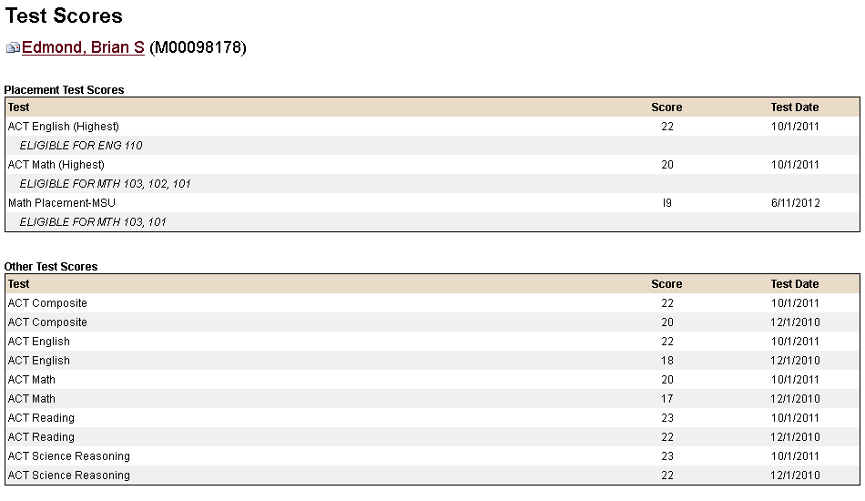
Custom Applications – Advising Notes / Test Scores

Slide 16
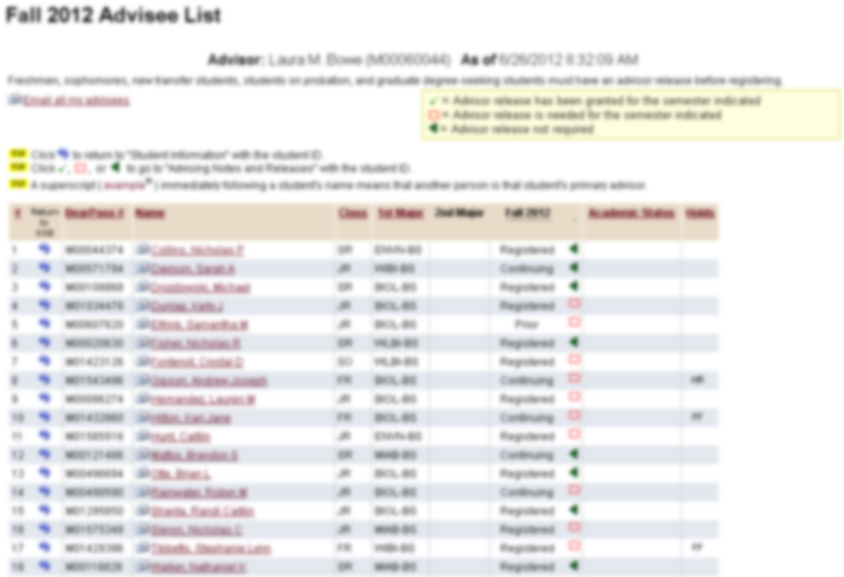
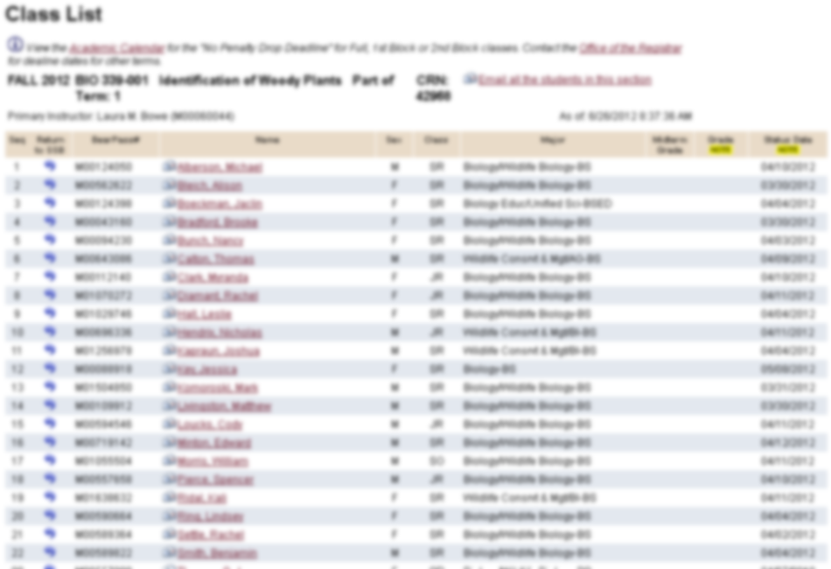
Custom Applications – Advisee List / Class List

Slide 17
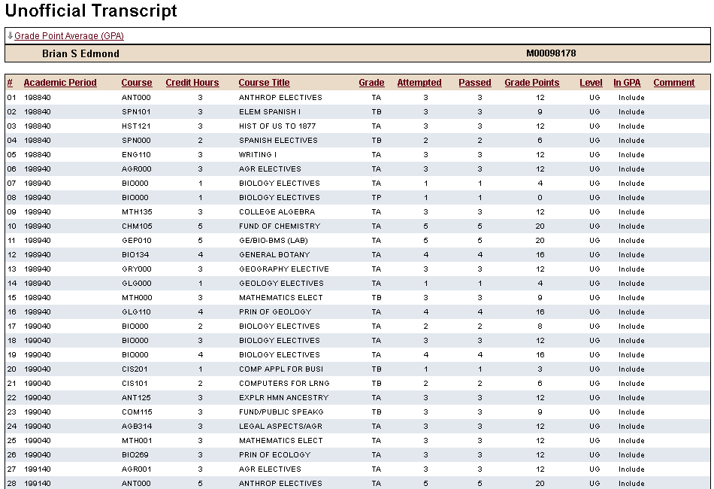
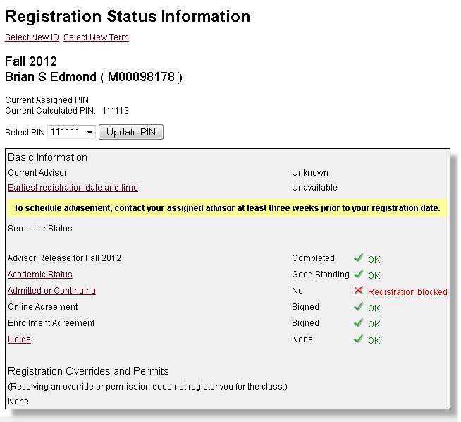
Custom Applications – Unofficial Transcript / Registration Status

Slide 18
Student Reevaluation Request
Notes:
Advisor release required

Slide 19
Student Reevaluation Request

Slide 20
Student Reevaluation Request

Slide 21
Student Reevaluation Request

Slide 22
Student Preapproval Request

Slide 23
Manage Requests

Slide 24
Manage Requests

Slide 25
Approve / Deny Requests

Slide 26
Advising Notes

Slide 27
Transfer Credit Evaluation

Slide 28
System Usage Data
2300 reevaluation requests in first 12 months
1200 approved (350 for all students)
227 given approval for a different course
1,080 preapproval requests (including 39 for study away)
635 approved (99 for all students)
97 given approval for a different course
Nearly every department has received requests

Slide 29
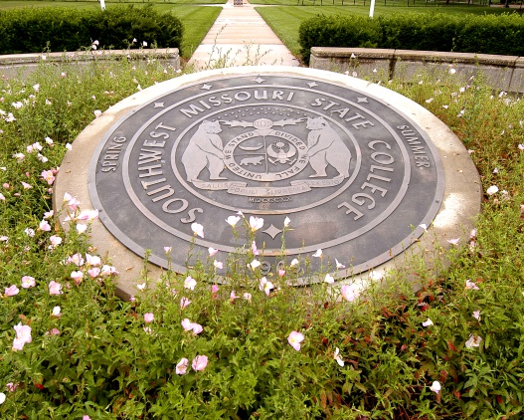
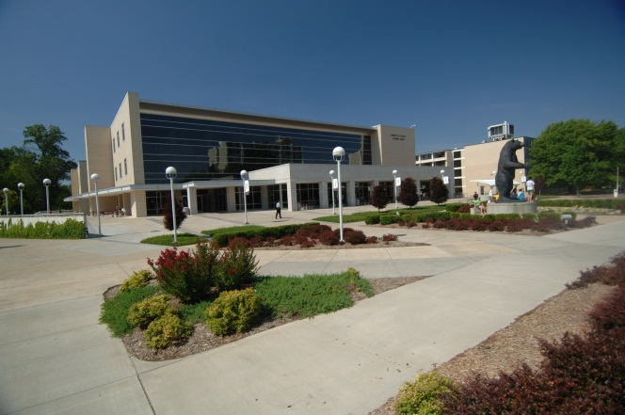
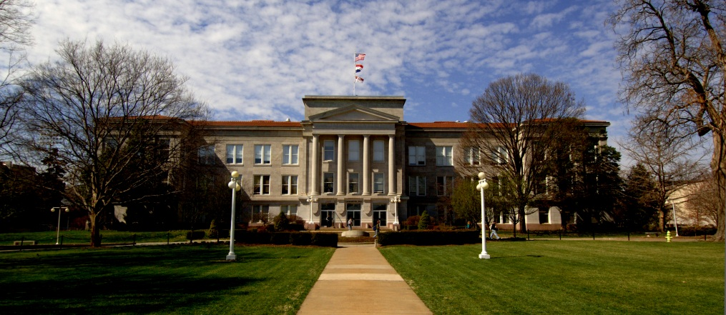

Slide 30
What We Wanted to Hear
“I just did my first on-line transfer credit re-evaluation. LOVE IT! You and your people did a great job! ”
Notes:
Department initiated reevaluation
Streamlined process for department heads
Automated reminders to department heads

Slide 31
Survey of New Transfers Fall 2012 Semester
37% of students surveyed talked with advisor about having credit reevaluated. Of those:
86% said their advisor was knowledgeable about the process
45% had actually utilized the system
Of those who utilized the system, 48% were very satisfied and 33% were moderately satisfied
Notes:
17% neutral
2% dissatisfied

Slide 32
What’s Next?
Ability to attach documents (e.g., course syllabi) to requests
Similar system for degree program substitutions and waivers
Notes:
Staff- “NO MORE PAPER FORMS”

Slide 33
Questions?
Don Simpson
Associate Vice President for Enrollment Management
Enrollment Services
DonSimpson@MissouriState.edu
Brian Edmond
Senior Systems Analyst
Computer Services – MIS
BrianEdmond@MissouriState.edu

