Slide 1

New Program
CBHE Approved Site
Use this process to add a new program at your main campus or to a previously approved site
*Use the Existing Program tab to add a previously approved program to a new location

Slide 2
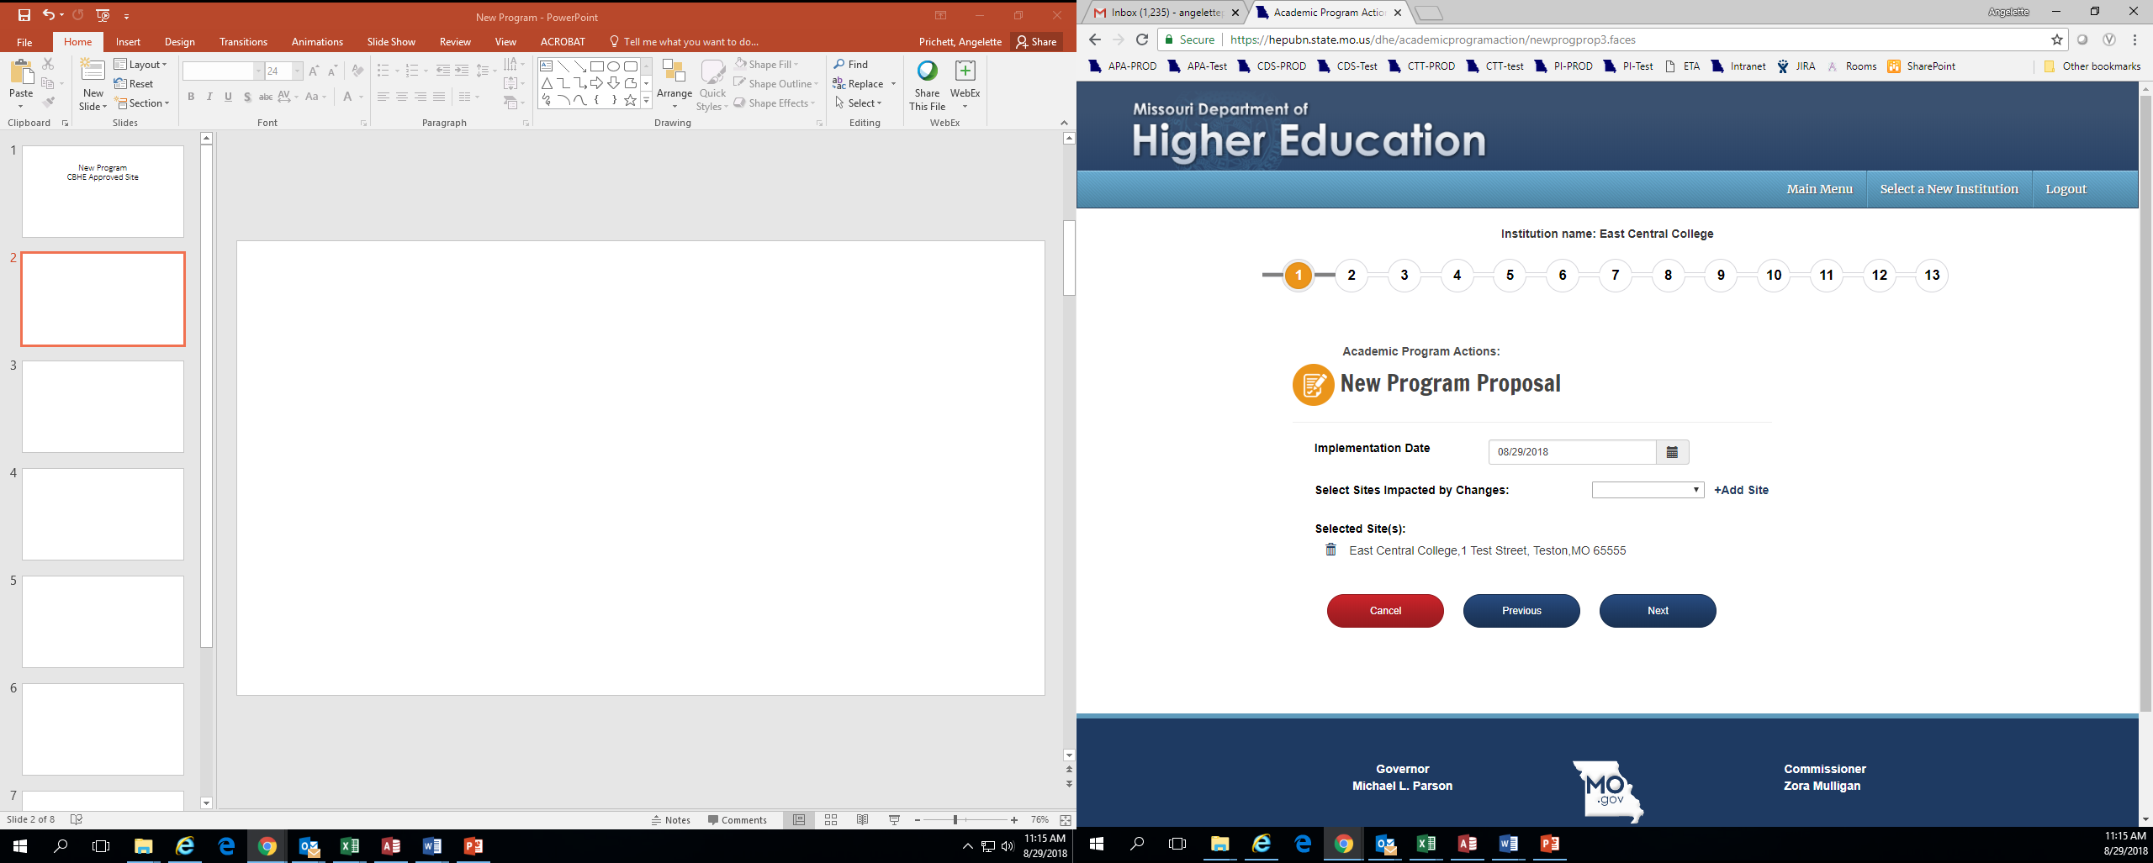
You should see your institution’s name at the top of the screen. If you manage academic program approvals for multiple institutions, confirm that you are submitting for the correct institution.
The numbers 1-13 indicate how many pages are included in the submission process.
Implementation Date: This is the date the program will begin to be offered. The date format is always MM/DD/YYYY.
Select sites impacted by Changes tells the system where you plan to offer the program. Your main campus has the same name as your institution name. After choosing one site, click Add Site. It will then appear under Selected Site(s). You may choose multiple sites from the dropdown list by clicking Add Site after each. If you have added a site by mistake, you can discard it by clicking the trashcan.
New Program-CBHE Approved Site
You will not be able to advance from screen to screen until all required fields are completed.

Slide 3
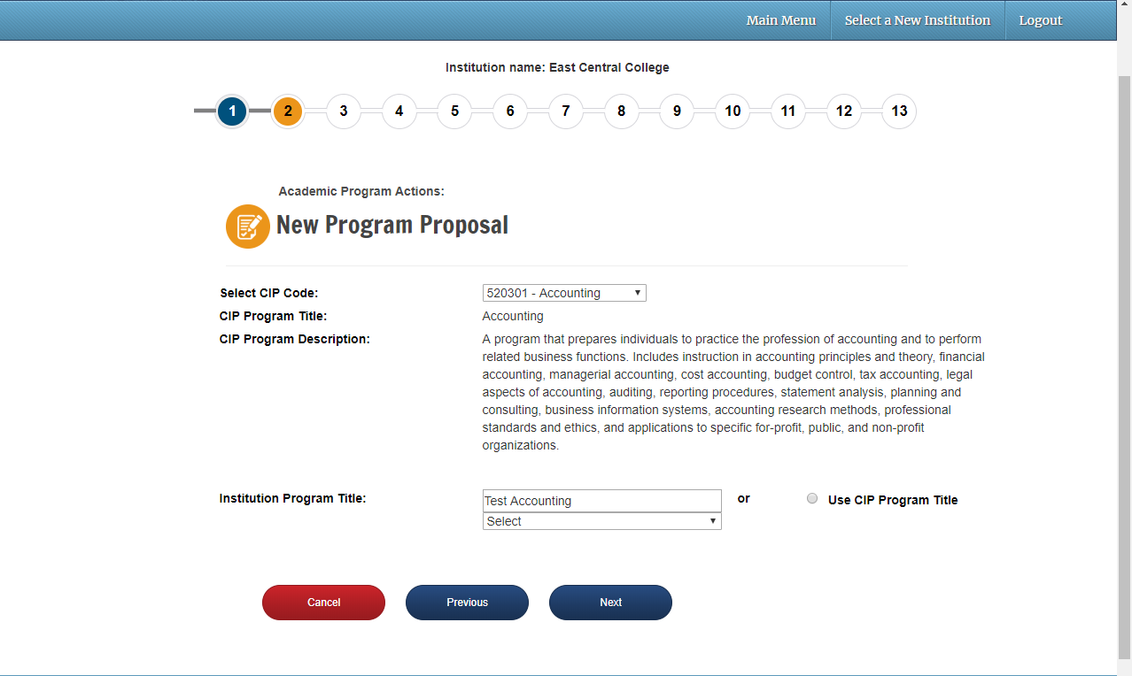
Select the program’s CIP code. CIP codes are in alphabetical order. CIP code titles can be looked up: https://nces.ed.gov/ipeds/cipcode/Default.aspx?y=55.
The CIP code title and program description from IPEDS will appear here.
Enter the program title here, or choose the radio button to use the CIP program title.
New Program-CBHE Approved Site

Slide 4
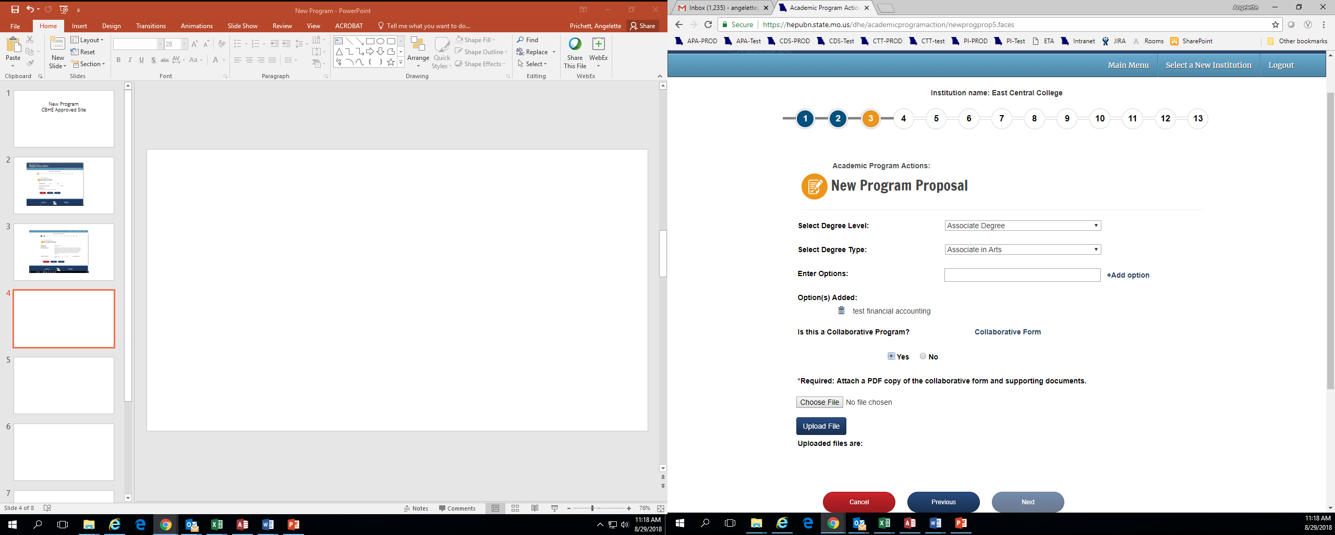
Choose the program’s degree level (Associate Degree, Bachelor’s Degree, etc.).
Choose the degree type. If you do not see your program’s degree type on the list, please contact MDHE so they can add it.
If the new program has options, enter the title here and click Add Option.
If the new program is being offered in collaboration with another institution of higher education, choose Yes. If not, choose No.
If Yes, download, complete and save the Collaborative Form on your computer.
Upload the completed file. Only PDFs can be attached (no Word docs).
New Program-CBHE Approved Site

Slide 5
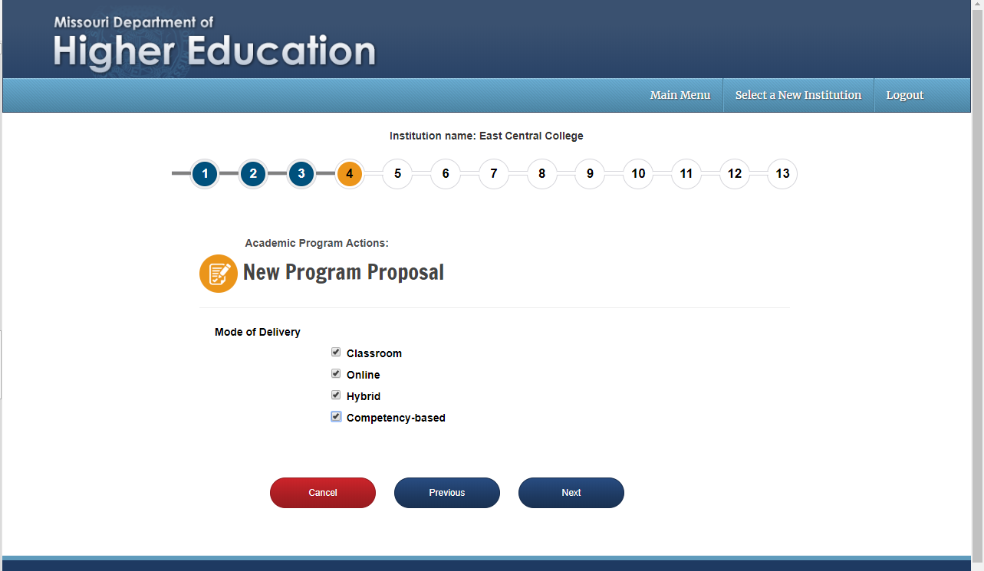
Indicate how your program will be delivered. Note that Online programs will no longer appear as a separate entry in the MDHE program inventory.
New Program-CBHE Approved Site

Slide 6
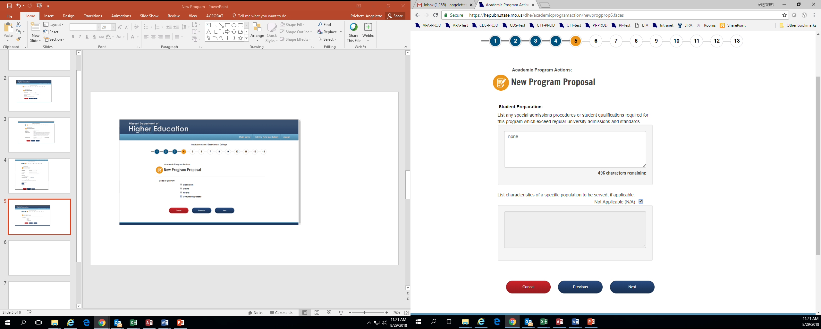
Provide a response, or type “none” if there are no special admissions requirements. Note that there is a feature to upload additional documents at the end of this process should you need more room to answer the question.
Provide a response, or check the N/A box if there are no specific populations served by the new degree program. Note that there is a feature to upload additional documents at the end of this process should you need more room to answer the question.
New Program-CBHE Approved Site

Slide 7
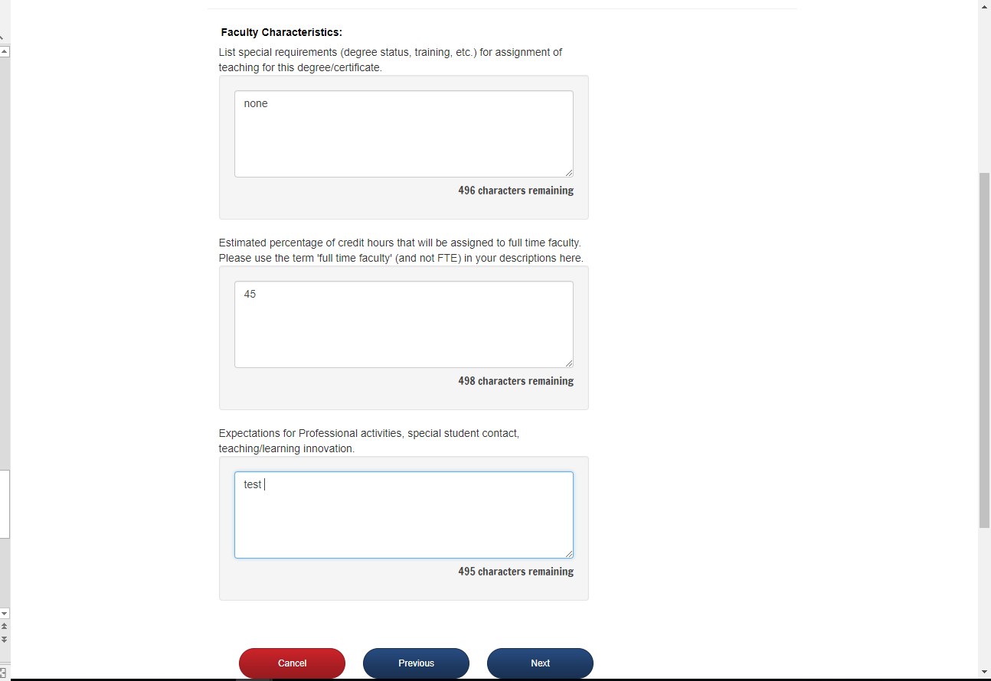
Please provide a response, or type “none” if there are no special faculty requirements. Note that there is a feature to upload additional documents at the end of this process should you need more room to answer the question.
Please provide a percent, and any supporting information. Note that there is a feature to upload additional documents at the end of this process should you need more room to answer the question.
Please provide a response, or type “none” if there are no expectations. Note that there is a feature to upload additional documents at the end of this process should you need more room to answer the question.
New Program-CBHE Approved Site

Slide 8
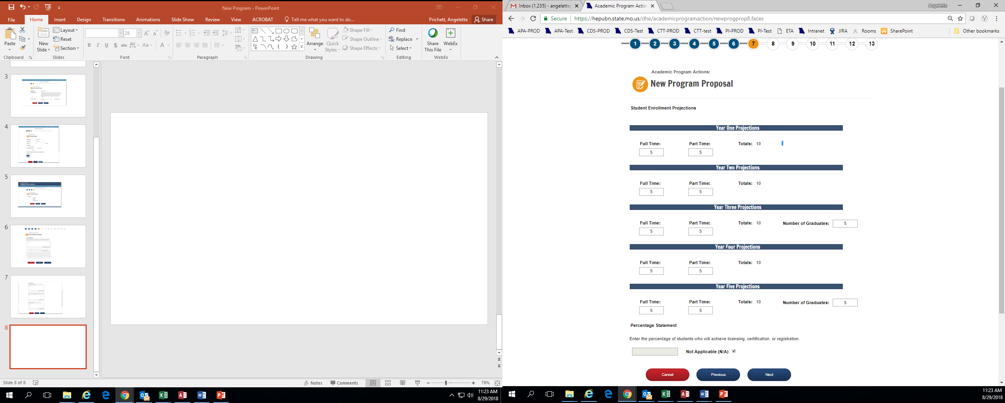
Enter the projected number of students enrolled in years 1 – 5.
Enter the number of projected graduates in years 3 and 5.
Enter the percentage of students who are projected to achieve licensing, certification, or registration, if applicable.
New Program-CBHE Approved Site

Slide 9
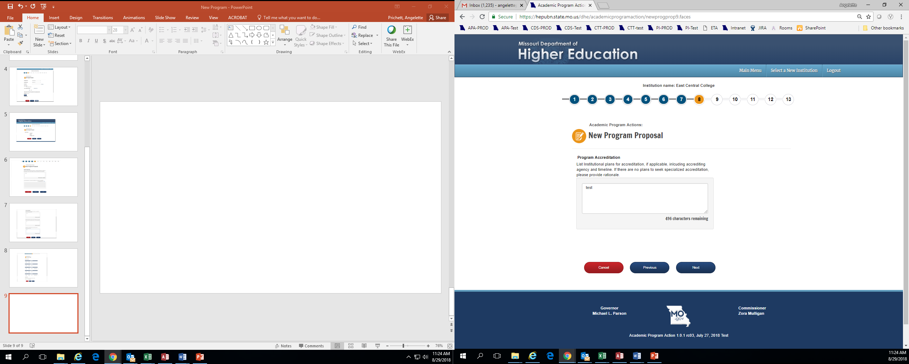
Enter the plans for accreditation, or if no plans provide rationale. Note that there is a feature to upload additional documents at the end of this process should you need more room to answer the question.
New Program-CBHE Approved Site

Slide 10
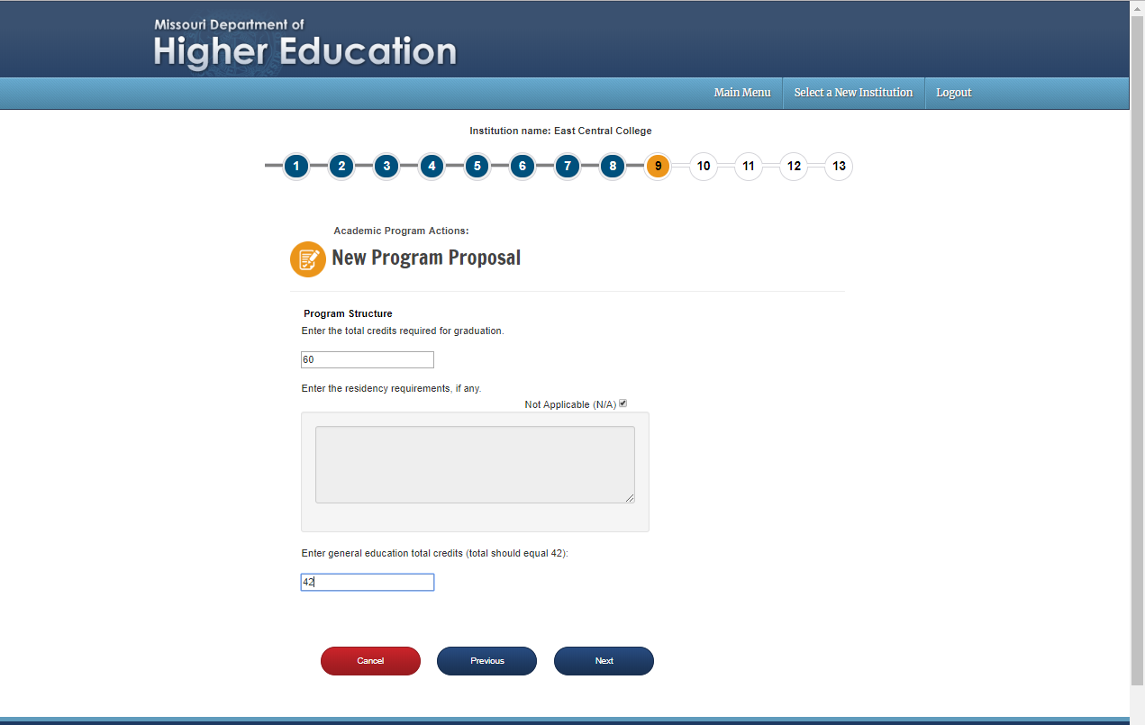
Enter the total number of credits in the program here.
Enter the residency requirements, or check N/A.
Enter the general education total credits. While the suggestion is 42, other totals can be entered here without disrupting the process.
New Program-CBHE Approved Site

Slide 11
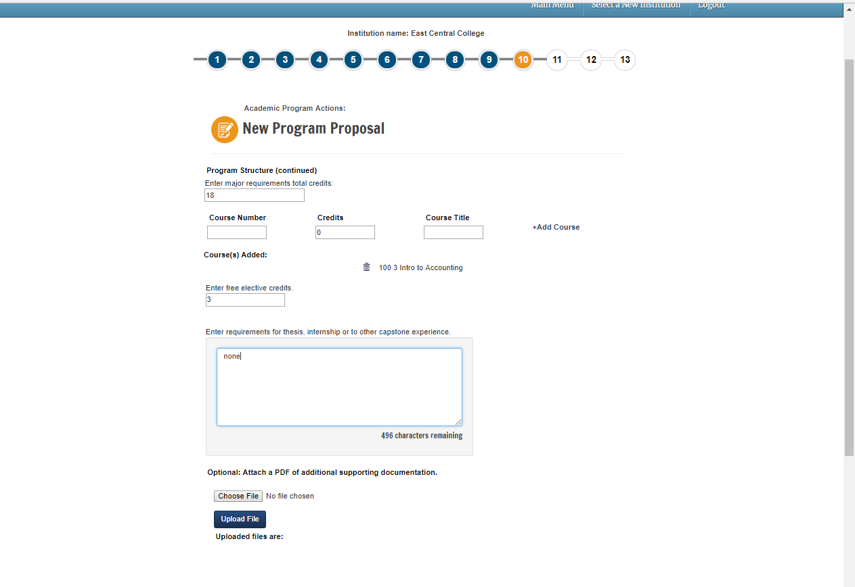
Enter the total number of major requirement credits in the program here.
Enter each course in the major. When you are done entering a course, hit Add Course. Your fields will clear and then you can add the next course. Note that you will also have to upload a pdf of the curriculum at the end of this process.
Enter the number of elective credits.
If there is a thesis, internship, or capstone requirement, describe it here.
Any additional supporting information about the program structure can be attached here.
New Program-CBHE Approved Site

Slide 12
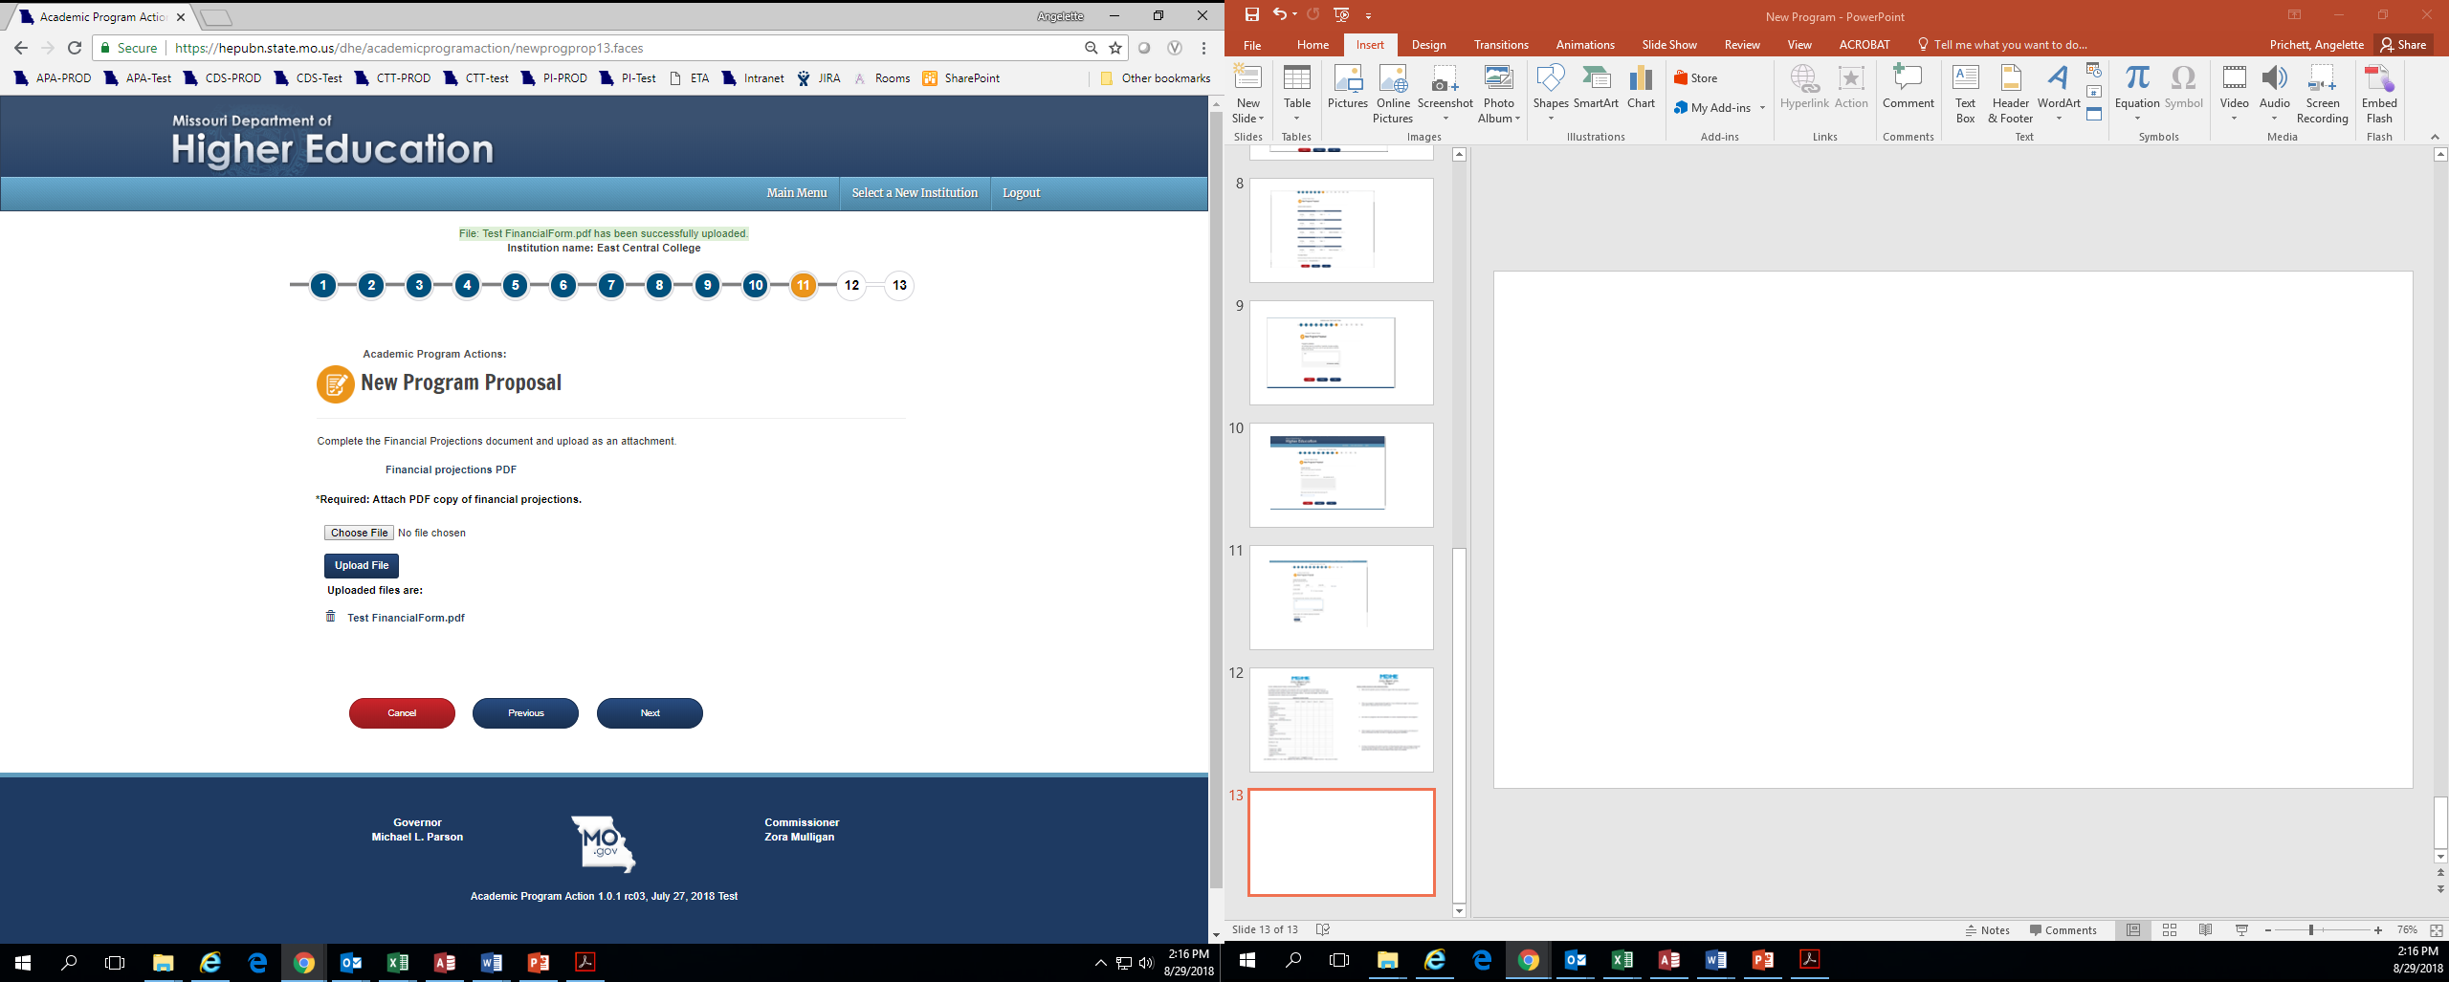
Click to open the Financial Projections PDF. Save it on your computer, complete it, and then re-upload the document (public institutions only).
New Program-CBHE Approved Site

Slide 13
Financial Projections Form
This form must be completed by public institutions proposing a new program. Independent institutions will not see the prompt to download this form.

Slide 14
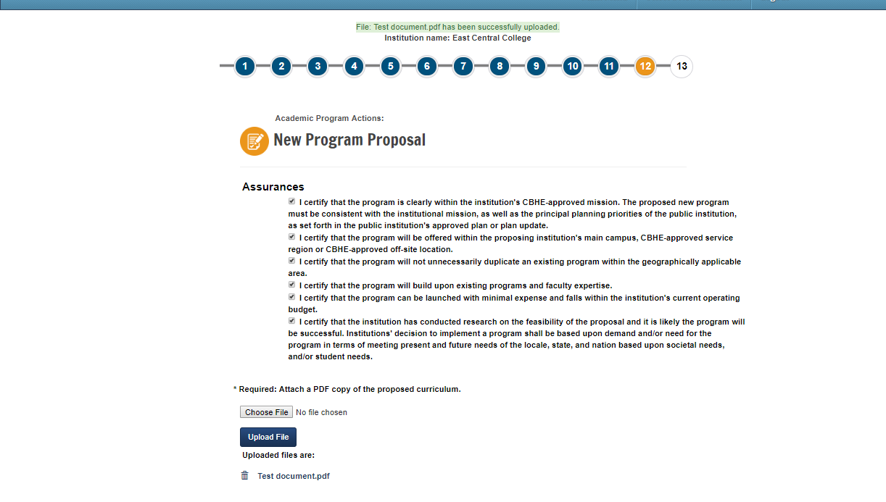
Read and check the assurances. Assurances for public institutions will be different from independent institutions.
Upload a PDF of the proposed new curriculum.
New Program-CBHE Approved Site

Slide 15
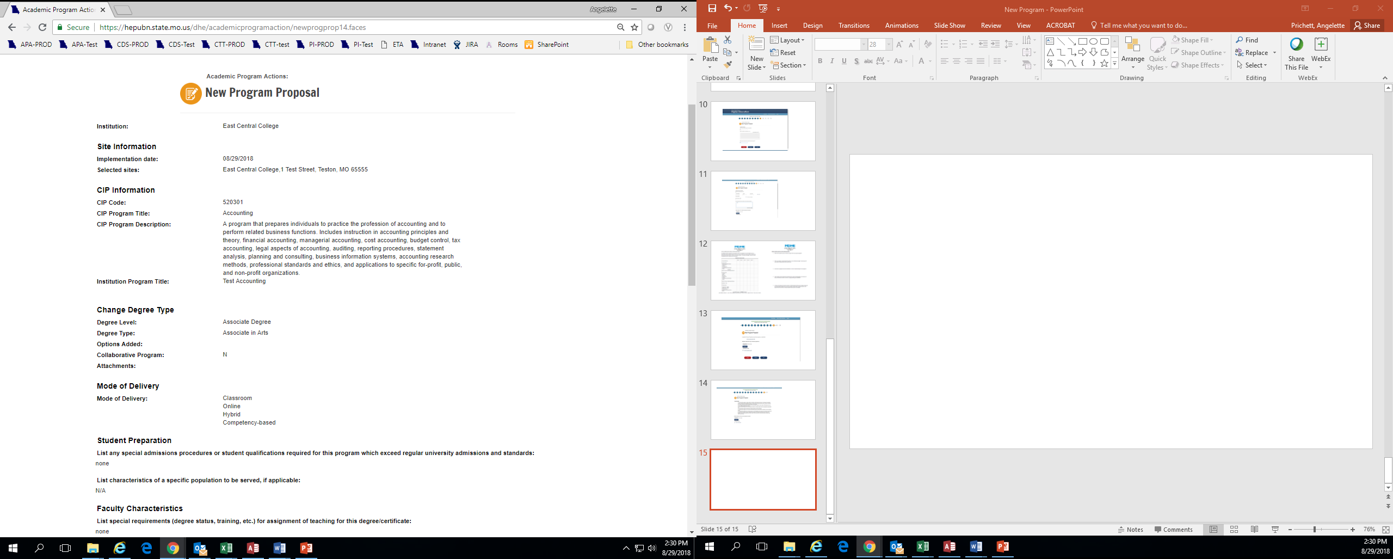
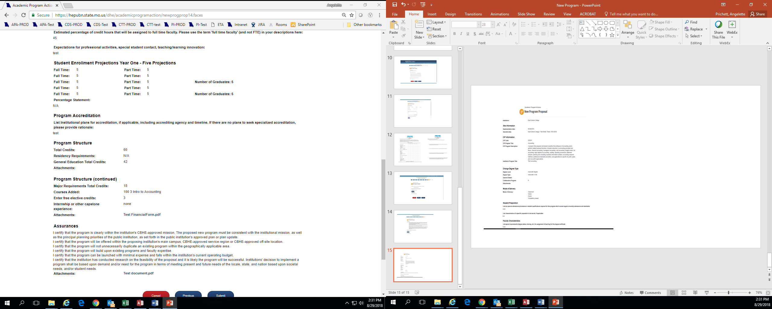
Before submitting, you will see a screen summarizing your program. If correct, choose Submit. If you hit Cancel, all of the information entered will be lost.
New Program-CBHE Approved Site

Slide 16
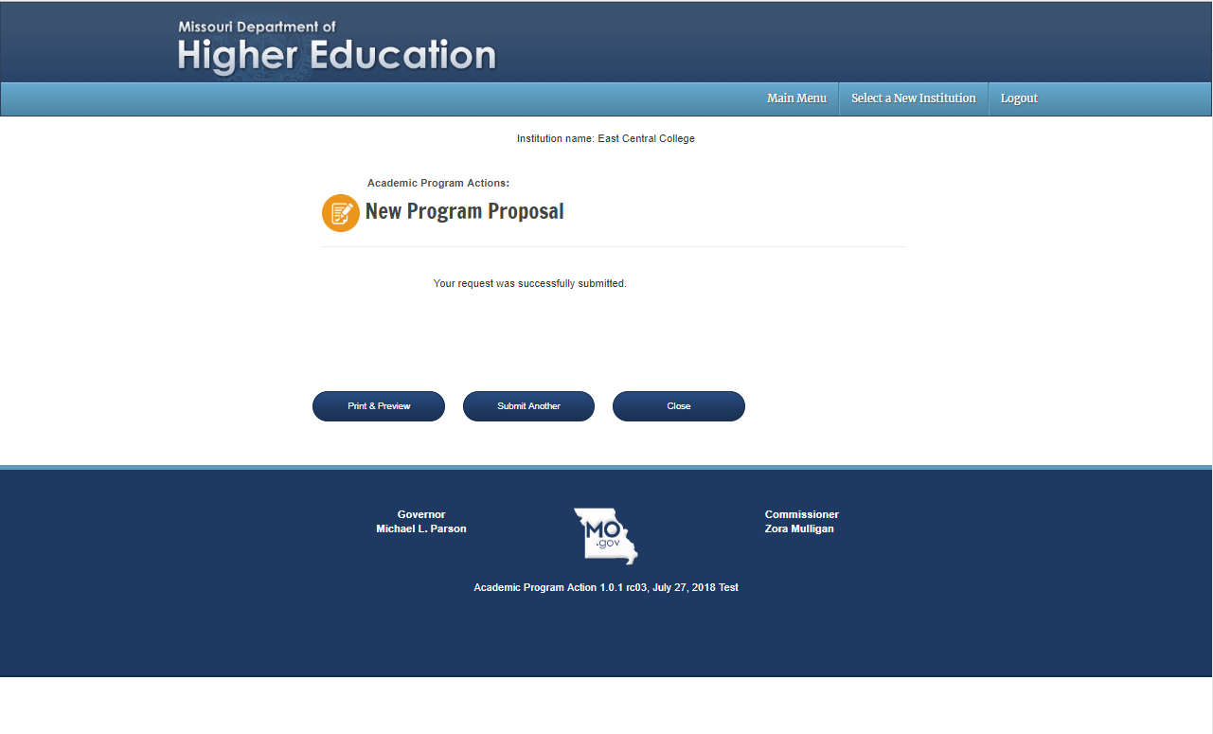
After submission, you can choose Print & Preview to save a copy for your files.
If you have additional new programs to submit, choose Submit Another.
Close takes you back to the main menu.
New Program-CBHE Approved Site

Slide 17
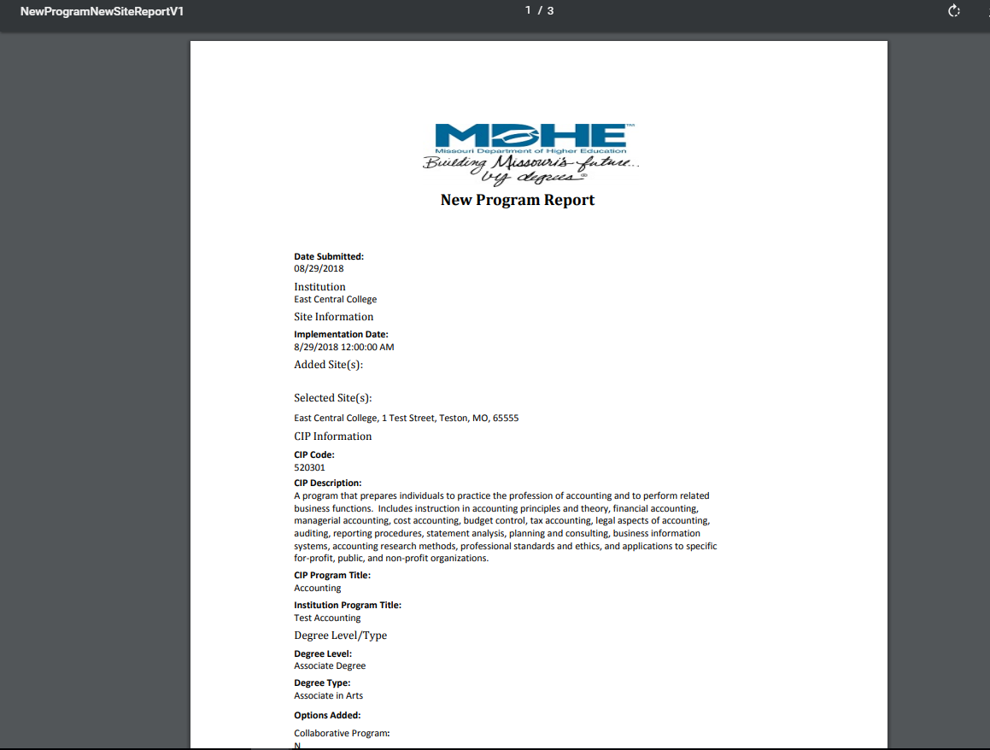
Once you have submitted a new program, it will enter a queue for staff review. It will be posted for review on the MDHE website on the first business day of the next month. Upon approval, your program will be uploaded to the MDHE inventory.
Upon approval, your program will be assigned a unique identifier to help track changes and for data reporting.
New Program-CBHE Approved Site

